Slide 1
Unit 3 Practice Test Questions
On a sheet of paper answer each Test Practice Question.
Once you have finished the Practice Test see the teacher to check your answers.

Slide 2
Q1
In the visible light spectrum, which color is lowest in energy?

Slide 3
Q2
If a star's emission lines are redshifted, what can be said about the star's motion?

Slide 4
Q3
Compared to some ground based telescopes, the Hubble telescope is able to take clearer pictures of objects in space because

Slide 5
Q4
When looking at two different stars, a student notices that star A is bluish in color and star B is reddish in color. Which star has a higher temperature?

Slide 6
Q5
Given that the telescope has the f-number of 500 mm—f / 10 , what is the focal length?

Slide 7
Q6
The temperature of a star can be determined from its

Slide 8
Q7
Each element has a different electron configuration which results in what?

Slide 9
Q8
A cooler cloud of hydrogen gas around a star will result in what?

Slide 10
Q9
Which of the following is NOT a reason astronomers put large, expensive telescopes on mountains?
a) to get that much closer to the stars
b) to avoid bad weather and clouds
c) to avoid light pollution from cities
d) to avoid humidity and turbulence in the air

Slide 11
Q10
If you were comparing two different telescopes and telescope A had a larger aperture than telescope B, how would the images compare?

Slide 12
Q11
Which portion of the electromagnetic spectrum would an optical telescope use to display an image of a star?

Slide 13
Q12
Which electromagnetic waves is lowest in frequency?

Slide 14
Q13
Which portion of the spectrum could an astronomer use to detect temperature (heat) differences on the surface of a planet?

Slide 15
Q14
Which electromagnetic waves is highest in energy?

Slide 16
Q15
Which type of electromagnetic wave covers the smallest portion of the spectrum?

Slide 17
Q16
Which of the following is NOT a type of telescope?
a)reflecting
b)refracting
c)infrared
d)radio
e)all are types of telescopes

Slide 18
Q17
The top spectrum is an emission spectrum for hydrogen and the bottom is an absorption spectrum from a star. What can we infer about the star when we compare these two spectra?
Red
Hydrogen
:
Star:

Slide 19
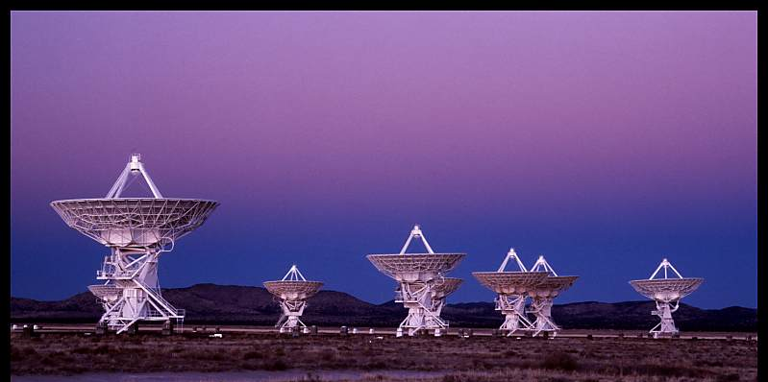
Q18
What kind of telescope is seen in the picture?

Slide 20
Q19
Large arrays of telescopes, like the Very Large Array (VLA), use interferometry to link up the signals of all the telescopes to improve what?

Slide 21
Q20
How do astronomers know what elements a star contains?

Slide 22
Q21
Which of the following measures would increase the magnification of the telescope?
a) decrease the aperture size
b) decrease the size of the primary mirror
c) use a longer focal length eyepiece
d) use a shorter focal length eyepiece

Slide 23
Q22
Earth’s atmosphere allows which of the following waves to pass through without being blocked or absorbed?

Slide 24
Q23
The patterns of the spectral lines (the absorption spectrum) contain
information about a star’s ?

Slide 25
Q24
If the telescope in the above diagram has 500 mm—f / 10 stamped on it, the aperture is

Slide 26
Q25
In the following diagram, which letter refers to the aperture of the telescope?
In the following diagram, which letter refers to the eyepiece of the telescope?
In the following diagram, which letter refers to the primary mirror of the telescope?
In the following diagram, which letter refers to the secondary mirror of the telescope?
Which piece of the telescope affects how much light is gathered?

Slide 27
Q26
The telescope in question 25 is what type of telescope?

Slide 28
Q27
If you were standing on Jupiter, you would be 5 times further away than the earth is from the sun. If you looked back at the sun, how would its brightness compare to that on earth?

Slide 29
Q28
If the same telescope [500 mm—f / 10 ] had an eyepiece with a focal length of 20 mm, what would be the magnification?

Slide 30
Q29
What does a charge-coupled-device (CCD) do for telescopes?

Slide 31
Q30
How do all electromagnetic waves compare?

Slide 32
Q31
An observer looking at the moon wants to obtain a wider field of view and see the moon in its entirety. What could the observer do to widen the field of view?

Slide 33
Q32
The main difference between a reflecting and a refracting telescope is

Slide 34
Q33
When an electron falls down to a lower energy level, what is the result?

Slide 35
Q34
The Doppler shift of a star’s spectral lines can be used to indicate?

