Slide 1
Mineral Cube Project

Slide 2
Mineral Cube Template
ALL OF YOUR TEXT has to fit within the text boxes provided. You may change the font, size, and color of the text. When done, you will print this out and cut out the squares.
You will make a cardboard box for your cube. The cube must be 6 x 6 inches
Cover the cardboard neatly with colored construction or wrapping paper. Glue your info in the center of each side.
You may decorate your cube anyway you like.
Include a way for me to hang up your cube- hook/ribbon/string, etc
Be neat, creative, and colorful, these will hang in our classroom.

Slide 3
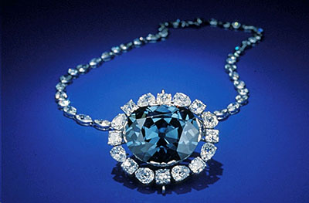
The boxes have to stay in size
SAMPLE
Everything you add to the boxes has to fit inside the lines
You will print out your slides full size. Either print in color or add color yourself. When you are done, and cut them out and add to your mineral cube
Diamonds
by Mrs. Meeks
Notes:
Image Source: The Hope Diamond https://www.si.edu/Encyclopedia_SI/nmnh/images/hopediamond.jpg

Slide 4
Top of cube
Do not change the SIZE of the box below
This box includes:
Name of Mineral
Your name
Block #
Picture of your Mineral
Notes:
add links to your sources here

Slide 5
Bottom of cube
Do not change the SIZE of the box below
This box includes:
2 + Pictures of (Write your Mineral Name here)
(You must have at least
two pictures of your mineral)
(The pictures are to show the mineral in an unprocessed or raw form, as it looks when it is found in
the ground or in a mine)
Notes:
add links to your sources here

Slide 6
Side 1 of cube
Do not change the SIZE of the box below
This box includes:
Chemical Properties of (Mineral)
Chemical Formula:
Mineral Group:
Crystal System:
What the crystal looks like: give a general description
Notes:
add links to your sources here

Slide 7
Side 2 of cube
Do not change the SIZE of the box below
This box includes:
Physical Properties of (Mineral)
Color(s):
Streak:
Luster:
Transparency
Hardness:
Specific Gravity:
Cleavage/Fracture:
Notes:
add links to your sources here

Slide 8
Side 3 of cube
Do not change the SIZE of the box below
This box includes:
About (Mineral)
(may use bullets or paragraphs to explain how your element is used, where it is found in the world, how did it gets its name, how does it form in nature, how much is mined each year, provide as much interesting information as you like, etc….)
Can add pictures, too
Notes:
add links to your sources here

Slide 9
Side 4 of cube
Do not change the SIZE of the box below
This box includes:
Uses of (Mineral)
1.
2.
3.
Add as many pictures of your
Mineral (3+) in a processed or useable form that you would like to add, minimum of 3)
Notes:
add links to your sources here

