Slide 1
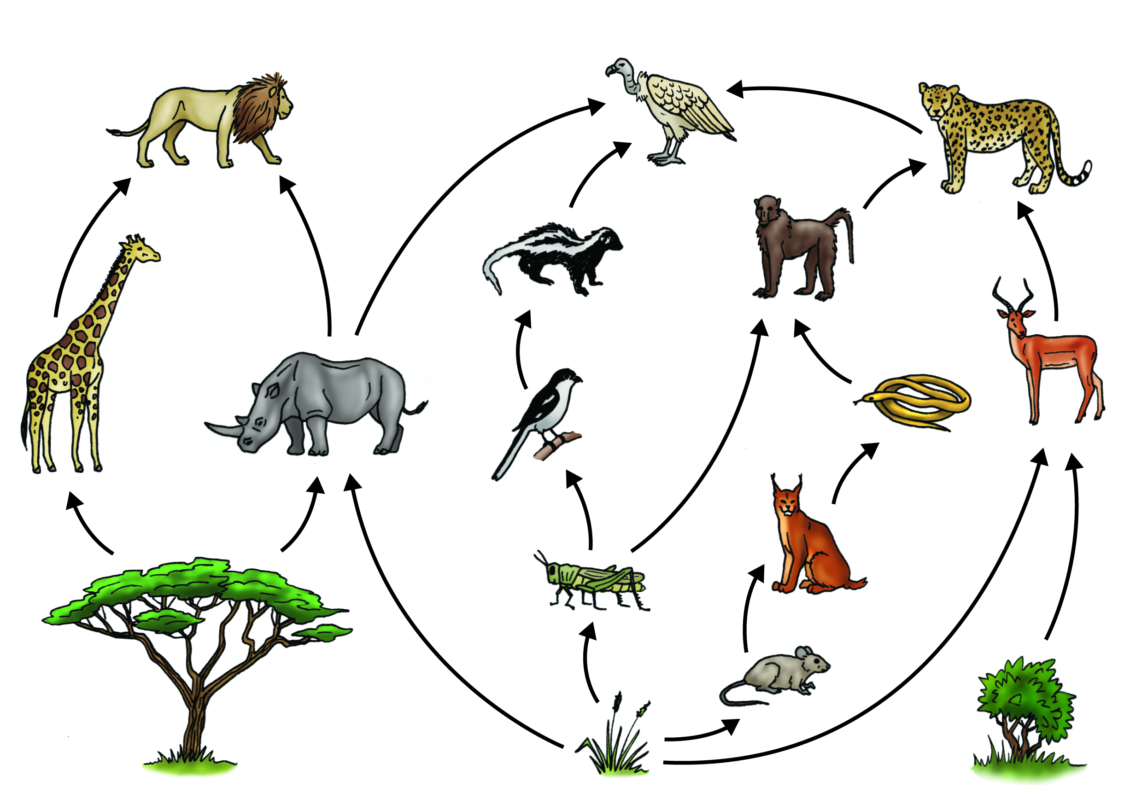
Food Webs & Energy Levels
This Photo by Unknown Author is licensed under CC BY

Slide 2
What is a Food Chain?
A food chain is the path by which energy passes from one living thing to another.

Slide 3
What’s in a Food Chain?
Producers
Consumers
Decomposers

Slide 4
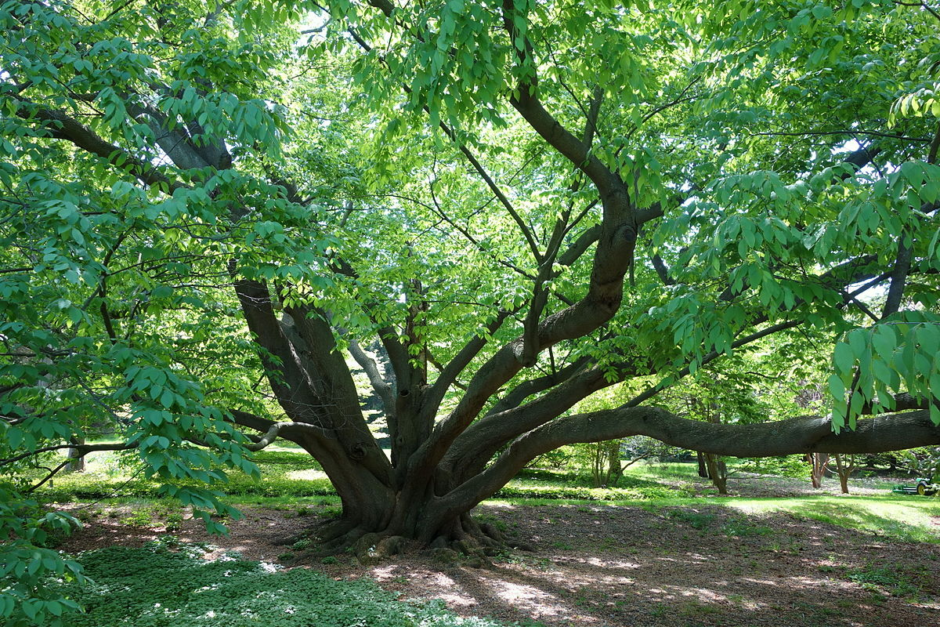
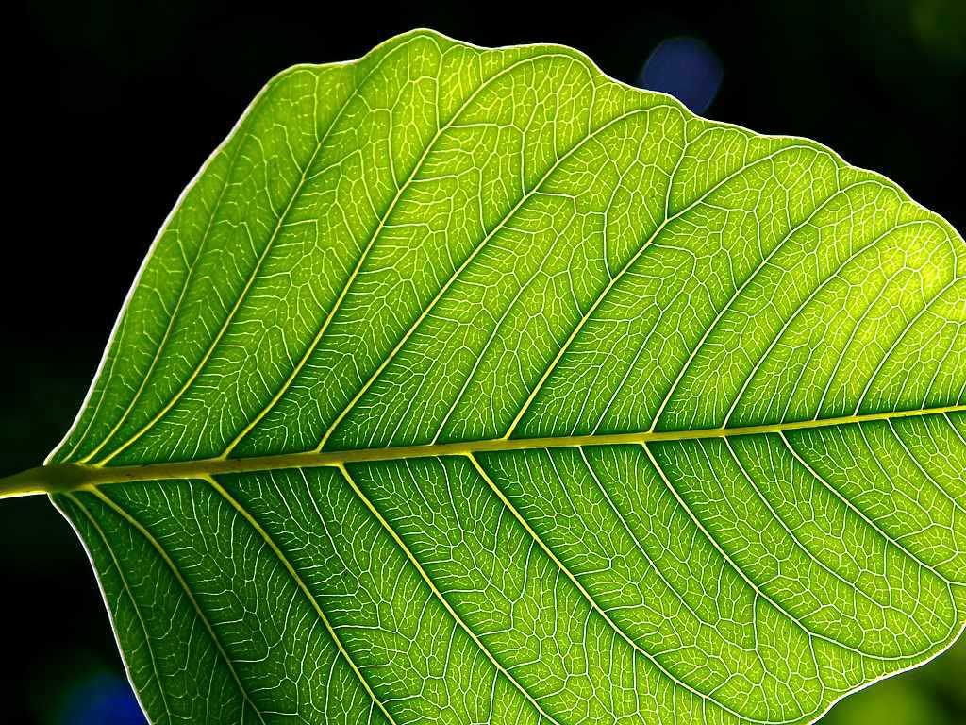
Producers
Organisms that can make their own energy through photosynthesis or chemosynthesis
This Photo by Unknown Author is licensed under CC BY-SA
This Photo by Unknown Author is licensed under CC BY-SA
Notes:
Add autotrophs

Slide 5
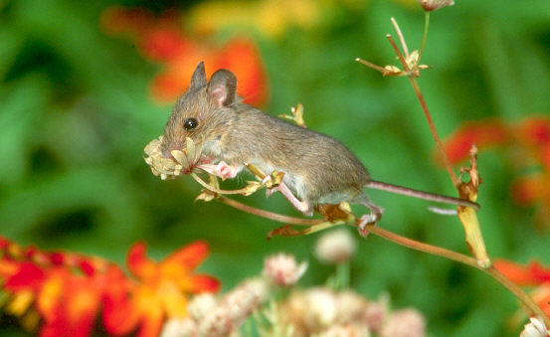
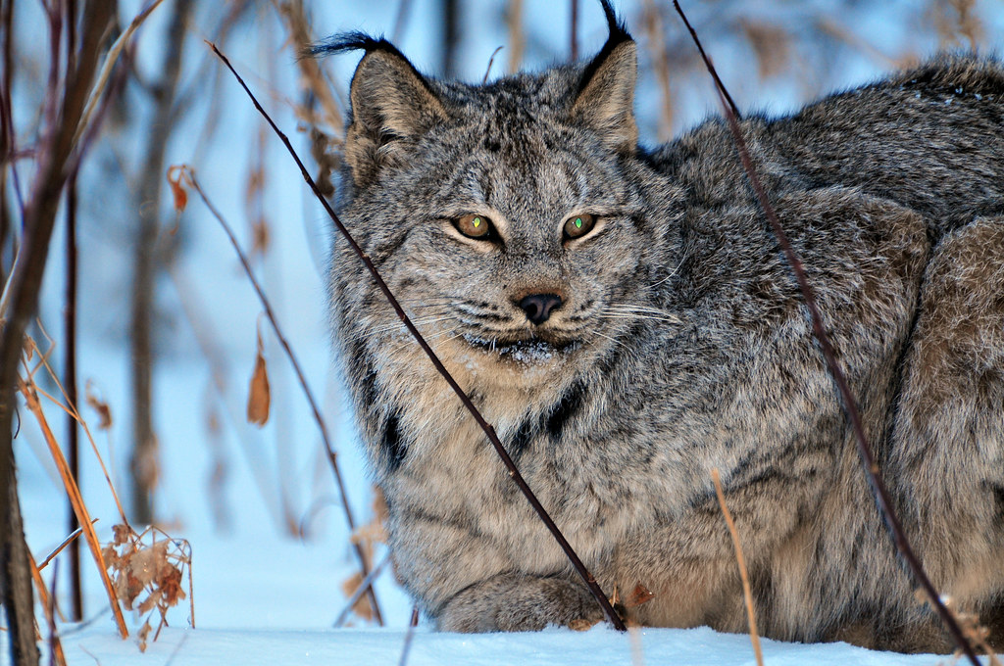
Consumers
Consumers hunt, gather, and store food because they cannot make their own.
This Photo by Unknown Author is licensed under CC BY
This Photo by Unknown Author is licensed under CC BY-NC-ND

Slide 6
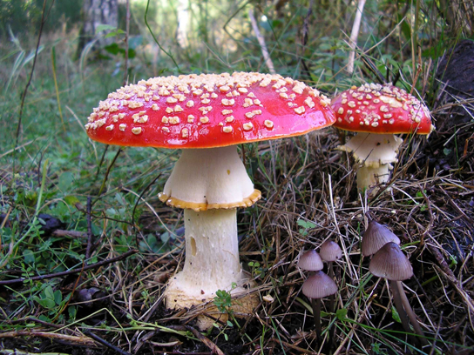
Decomposers
Microorganisms that break down large molecules into smaller parts
They return the nutrients that are in a living thing to the soil
This Photo by Unknown Author is licensed under CC BY-SA
Notes:
Beetles, earthworms & mushrooms

Slide 7
Three Types of Consumers
Herbivores
Carnivores
Omnivores

Slide 8
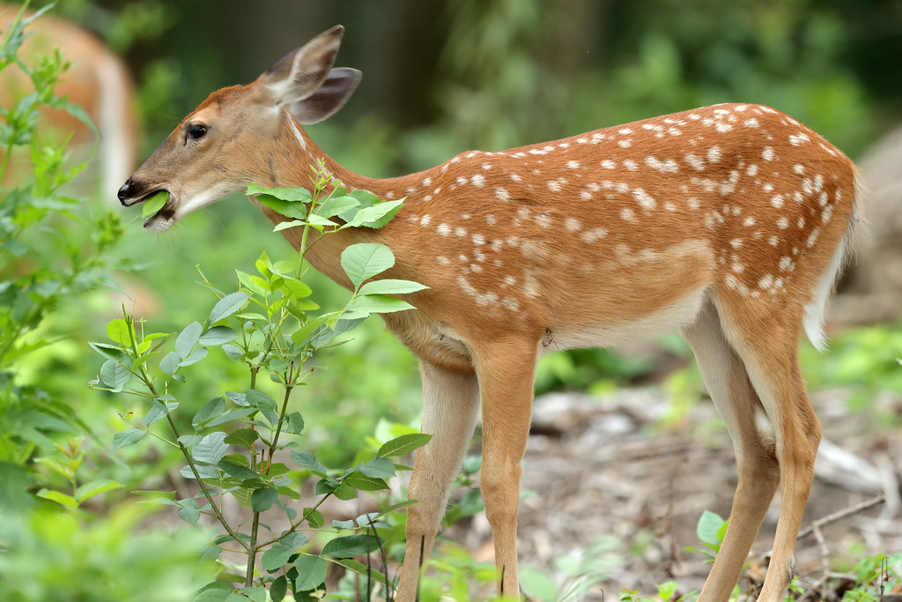
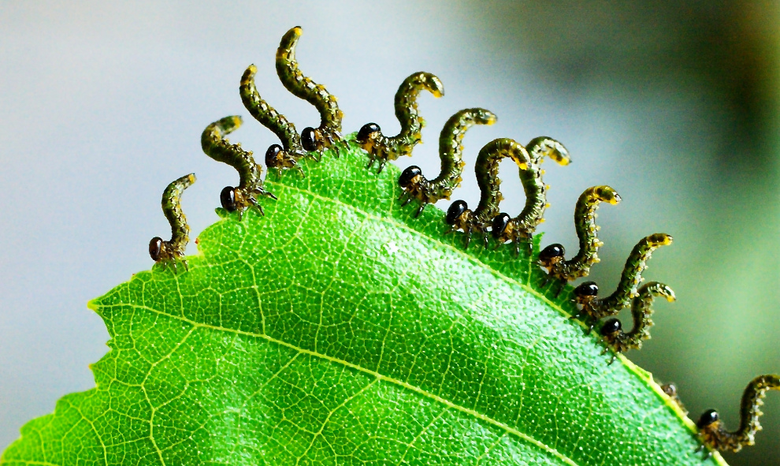
Herbivores
Animals who eat plants such as:
grasshoppers
rabbits
pandas
This Photo by Unknown Author is licensed under CC BY-SA
This Photo by Unknown Author is licensed under CC BY

Slide 9
Carnivores
Animals who only eat other animals such as:
tigers
lions
hawks
wolves
cougars
This Photo by Unknown Author is licensed under CC BY-SA

Slide 10
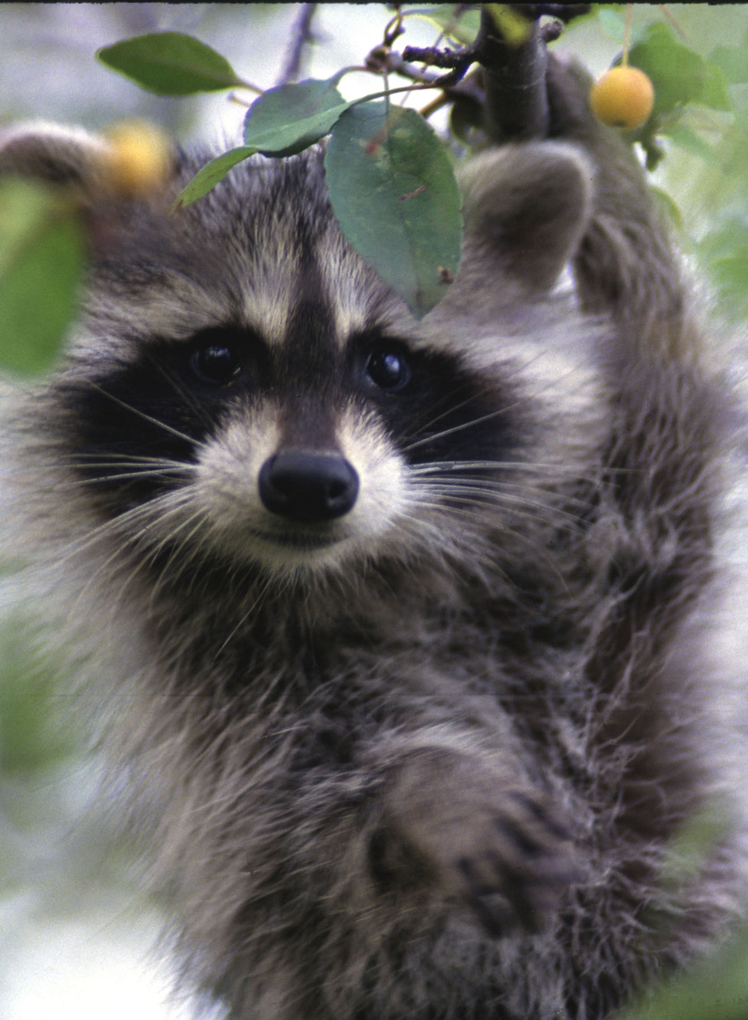
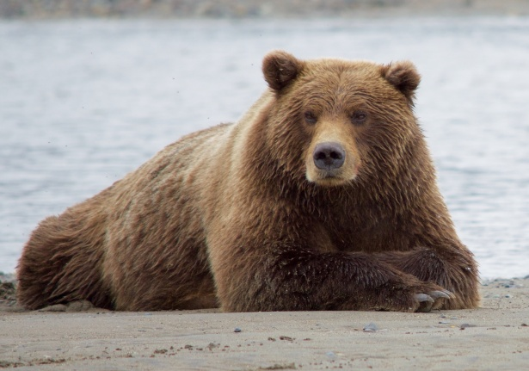
Omnivores
Animals who eat both plants and animals such as:
humans
bears
This Photo by Unknown Author is licensed under CC BY-SA

Slide 11
Types of Food Chains
Aquatic- Water-related food chains with sea plants and animals
Terrestrial- Land-related food chains with land plants and animals

Slide 12
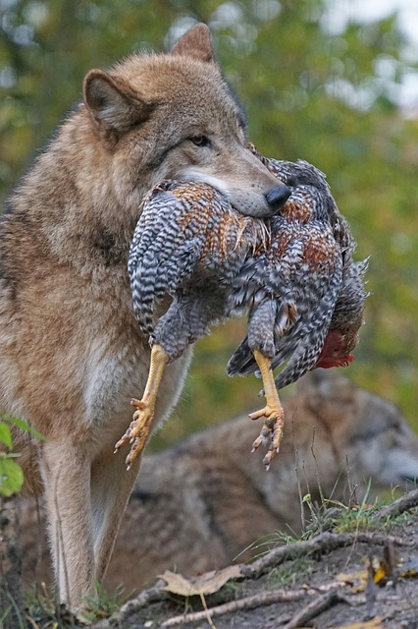
Predator & Prey
Predator- An animal that captures and eats other animals
Prey- The animal that is captured and eaten

Slide 13
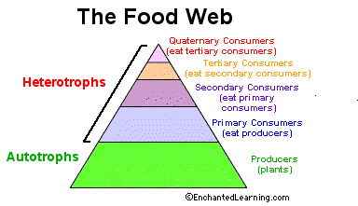
Levels of Consumers
Primary Consumer (Eat Producers/Plants)
Secondary Consumer (Eat primary consumers)
Tertiary Consumer (Eat Secondary Consumer)

Slide 15
Energy through the Trophic Levels
The law of 10%
Each level you go up in the trophic levels will use only 10% of the energy.
The remaining energy is lost as heat

Slide 16
What is a Food Web?
A more realistic way of looking at the relationship of plants and animals in an environment
Several food chains linked together
A predator from one food chain may be linked to the prey of another food chain

Slide 17
Food Webs
How many food chains can you make from this food web?

Slide 18
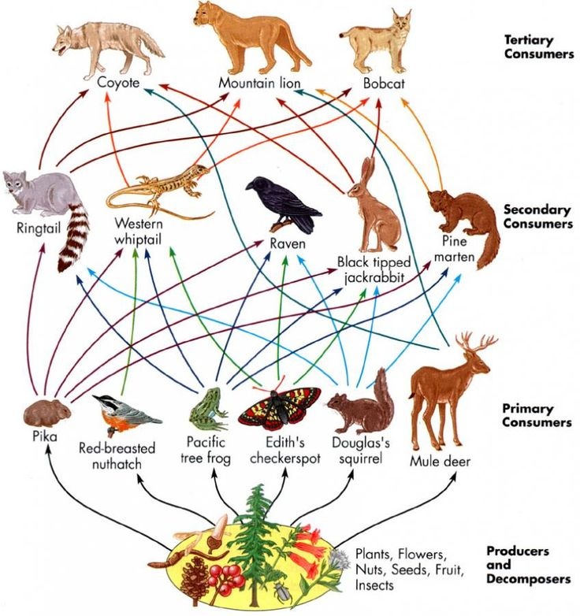

Slide 19
Food Web Activity
Create a food web using 4 organisms.
You must have a producer, primary consumer, secondary consumer and tertiary consumer
Cut out the organisms and glue them to your paper. Draw the arrows in. THEY MUST BE POINTING IN THE CORRECT DIRECTION.
Label the producer, primary consumer, secondary consumer and tertiary consumer
Outline the herbivores in green carnivores in red
On the back complete the following:
Why do the arrows point in the directions they do?
If the producers have 100 J of energy – label the amount of energy at each stage.
What happens to the energy that is lost?

