Slide 1
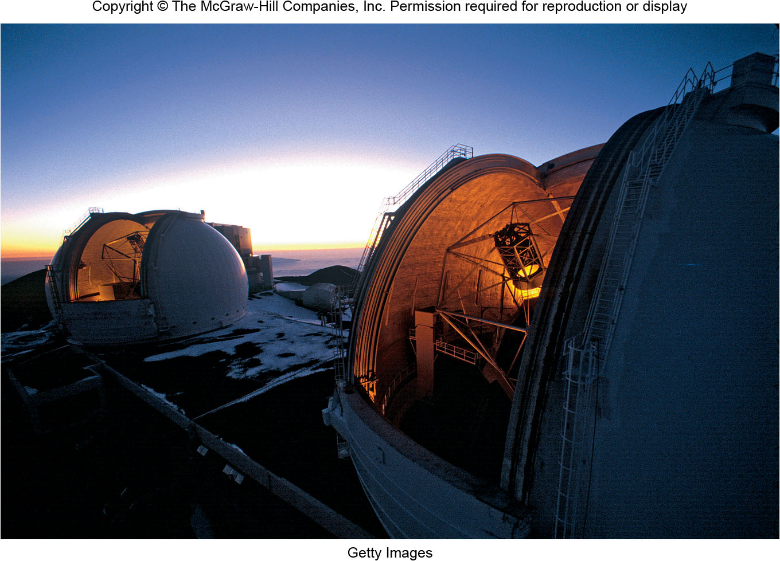
Chapter 5
Telescopes
Copyright © McGraw-Hill Education. Permission required for reproduction or display.

Slide 2
Tools of the Trade: Telescopes
Stars and other celestial objects are too far away to test directly
Astronomers passively collect radiation emitted from distant objects
Extremely faint objects make collection of radiation difficult
Specialized Instruments Required
Need to measure brightness, spectra, and positions with high precision
Astronomers use mirrored telescopes and observatories
Modern astronomers are rarely at the eyepiece, more often they are at a computer terminal!

Slide 3
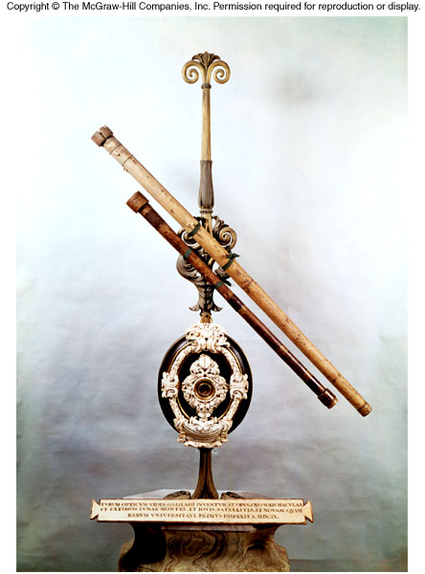
The Powers of a Telescope
Collecting Power
Bigger telescope, more light collected!
Focusing Power
Use mirrors or lenses to bend the path of light rays to create images
Resolving Power
Picking out the details in an image

Slide 4
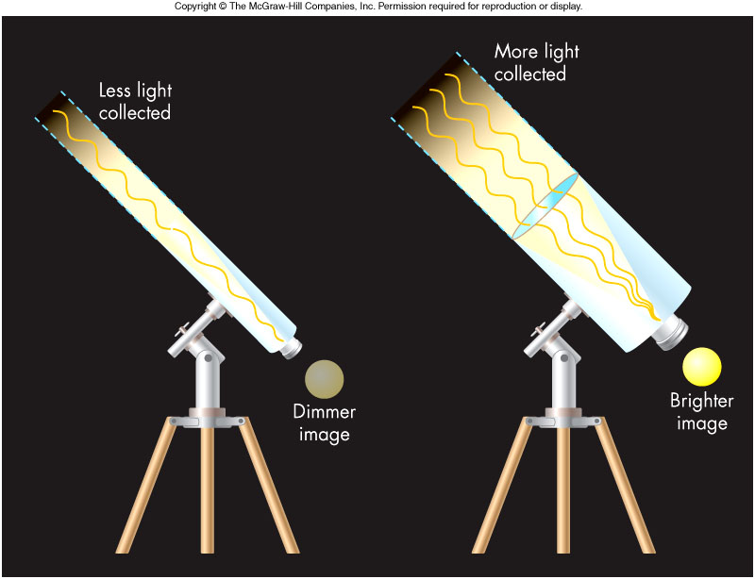
Light Gathering Power
Light collected proportional to “collector” area
Pupil for the eye
Mirror or lens for a telescope
Telescope “funnels” light to our eyes for a brighter image
Small changes in “collector” radius give large change in number of photons caught
Telescopes described by lens or mirror diameter

Slide 5
Focusing Power
Refraction
Light moving at an angle from one material to another will bend due to a process called refraction
Refraction occurs because the speed of light is different in different materials

Slide 6
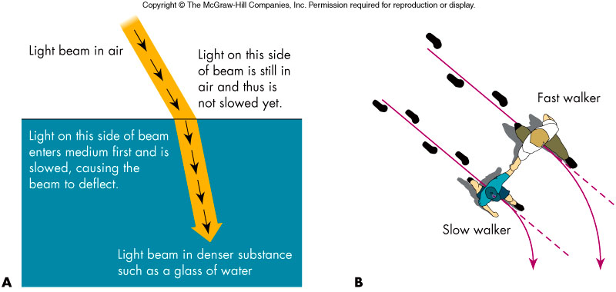
Refraction

Slide 7
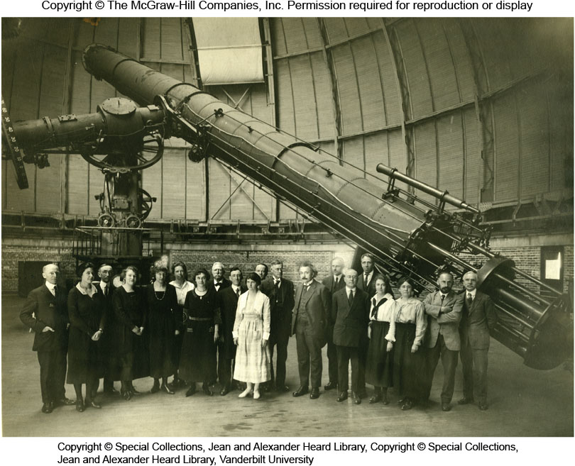
Refracting Telescopes
A lens employs refraction to bend light
Telescopes that employ lenses to collect and focus light are called refractors

Slide 8
Disadvantages to Refractors
Lenses have many disadvantages in large telescopes!
Large lenses are extremely expensive to fabricate
A large lens will sag in the center since it can only be supported on the edges
Dispersion causes images to have colored fringes
Many lens materials absorb short-wavelength light

Slide 9
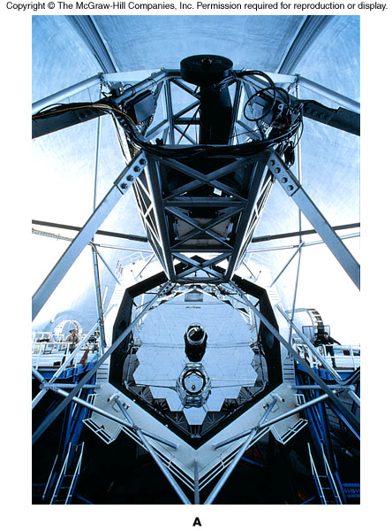
Reflecting Telescopes
Reflectors
Used almost exclusively by astronomers today
Twin Keck telescopes, located on the 14,000 foot volcanic peak Mauna Kea in Hawaii, have 10-meter collector mirrors!
Light is focused in front of the mirror

Slide 10
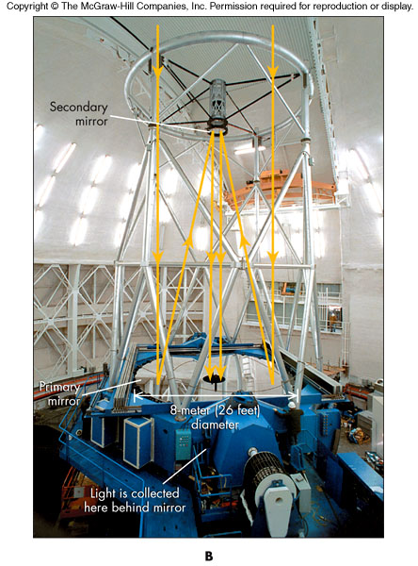
Mirrors in Reflectors
A secondary mirror may be used to deflect the light to the side or through a hole in the primary mirror
Multi-mirror instruments and extremely thin mirrors are two modern approaches to dealing with large pieces of glass in a telescope system

Slide 11
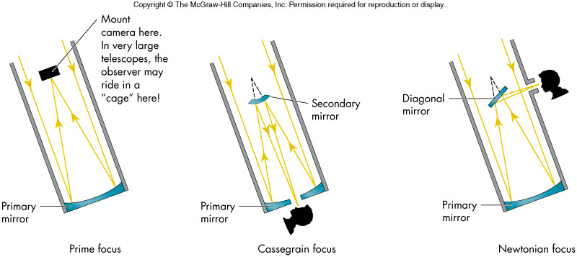
Styles of Reflectors

Slide 12
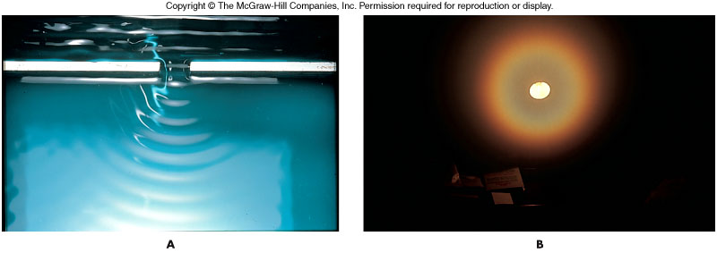
Resolving Power
A telescope’s ability to discern detail is referred to as its resolving power
Resolving power is limited by the wave nature of light through a phenomenon called diffraction
Waves are diffracted as they pass through narrow openings
A diffracted point source of light appears as a point surrounded by rings of light

Slide 13
Resolving Power and Aperture
Two points of light separated by an angle α (in arcsec) can be seen at a wavelength λ (in nm) only if the telescope diameter D (in cm) satisfies:
D > 0.02 λ/α

Slide 14
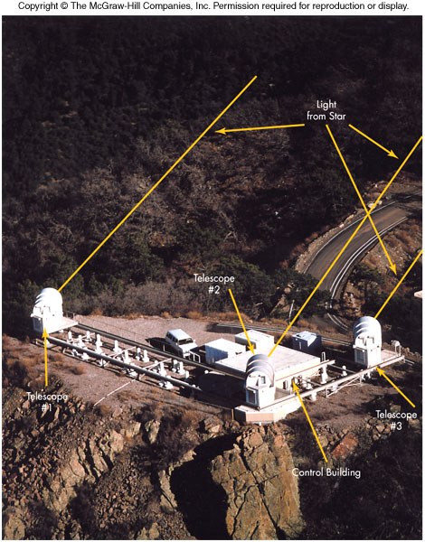
Increasing Resolving Power: Interferometers
For a given wavelength, resolution is increased for a larger telescope diameter
An interferometer accomplishes this by simultaneously combining observations from two or more widely-spaced telescopes

Slide 15
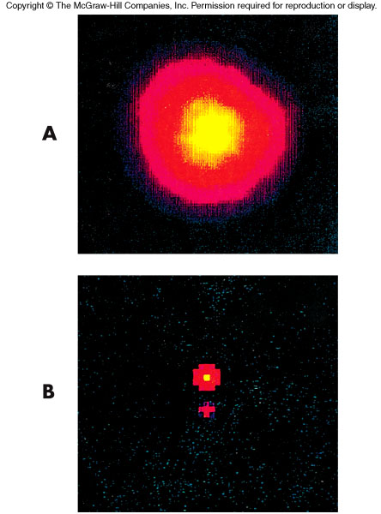
Interferometers
The resolution is determined by the individual telescope separations and not the individual diameters of the telescopes themselves
Key to the process is the wave nature of interference and the electronic processing of the waves from the various telescopes

Slide 16
Detecting the Light
The Human Eye
Once used with a telescope to record observations or make sketches
Not good at detecting faint light, even with the 10-meter Keck telescopes
Photographic Film
Chemically stores data to increase sensitivity to dim light
Very inefficient: Only 4% of striking photons recorded on film
Electronic Detectors
Incoming photons strike an array of semiconductor pixels that are coupled to a computer
Efficiencies of 75% possible
CCD (Charged-coupled Device) for pictures

Slide 17
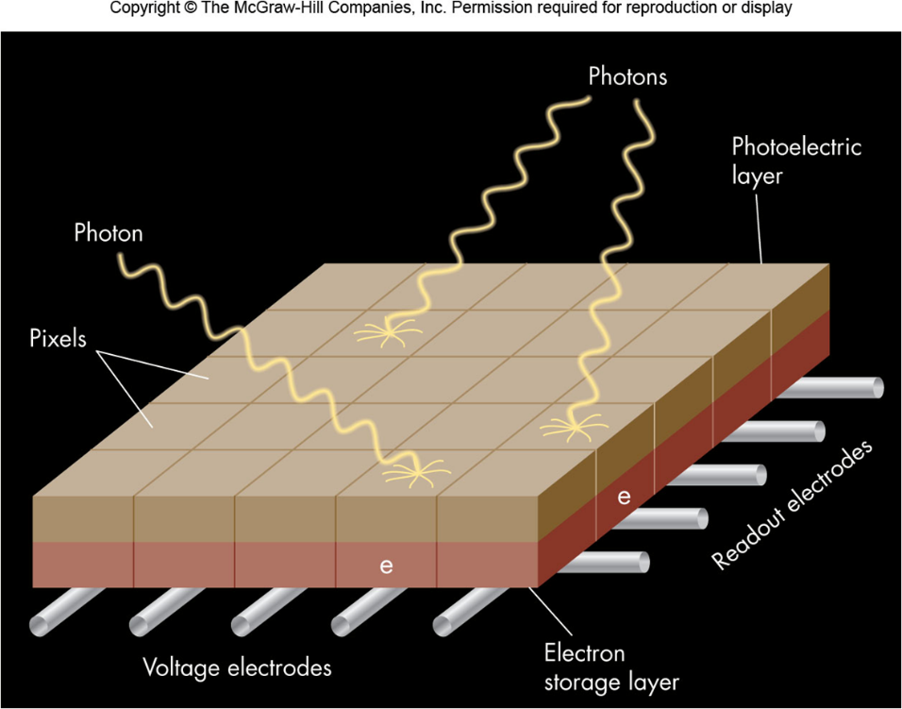
Charge-Coupled Devices (CCDs)
CCDs are ~20x more sensitive to faint light than photographic film
Incoming light strikes a semiconductor surface, freeing electrons
Number of electrons is proportional to intensity of the light.
Amount of charge liberated is read out to a computer to create an image.

Slide 18
Nonvisible Wavelengths
Many astronomical objects radiate in wavelengths other visible
Cold gas clouds radiate in the radio
Dust clouds radiate in the infrared
Hot gases around black holes emit x-rays

Slide 19
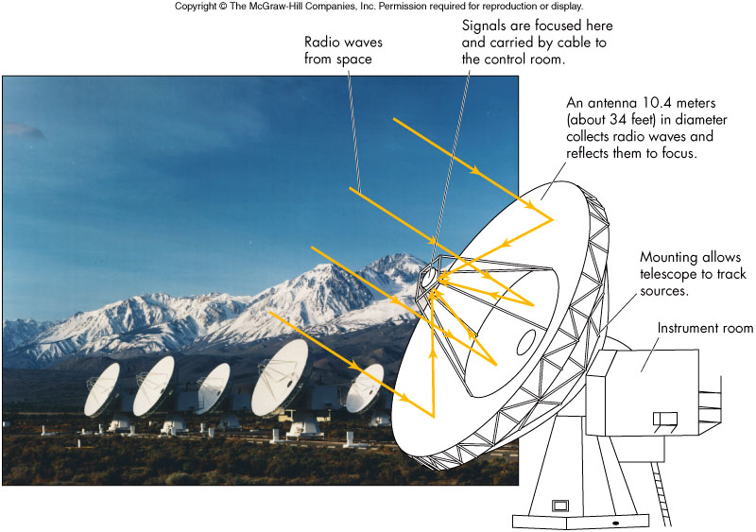
Radio Observatories

Slide 20
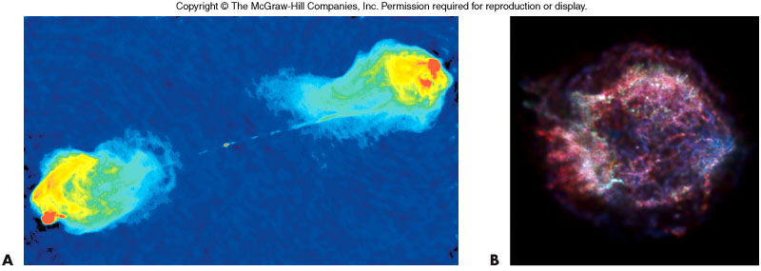
Radio Observations
False color images are typically used to depict wavelength distributions in non-visible observations

Slide 21
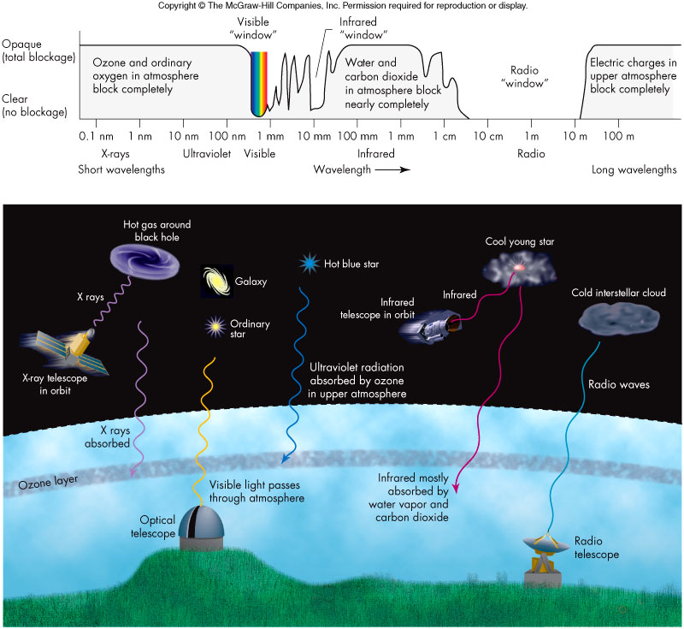
Atmospheric Windows

Slide 22
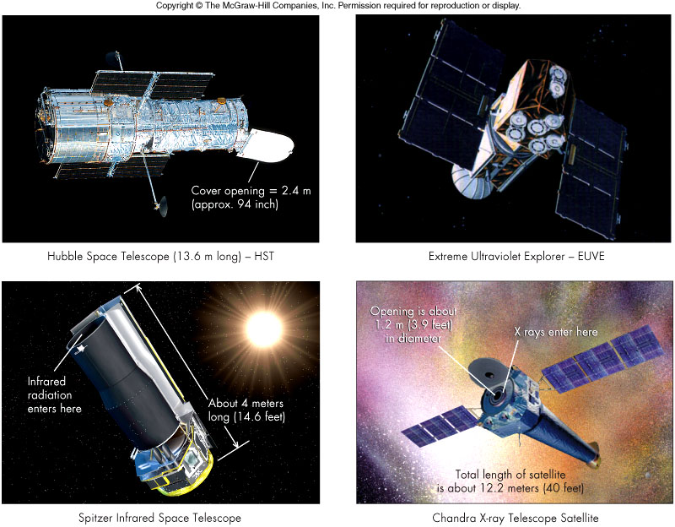
Major Space Observatories
Why put them in space?

Slide 23
Space vs. Ground-Based Observatories
Space-Based Advantages
Freedom from atmospheric blurring
Freedom of atmospheric absorption
Ground-Based Advantages
Larger collecting power
Equipment easily fixed
Ground-Based Considerations
Weather, humidity, and haze
Light pollution

Slide 24
Observatories
The immense telescopes and their associated equipment require observatories to facilitate their use and protection from the elements
Thousands of observatories are scattered throughout the world and are on every continent including Antarctica
Some observatories:
Twin 10-meter Keck telescopes are largest in U.S.
The Hobby-Eberly Telescope uses 91 1-meter mirrors set in an 11-meter disk
Largest optical telescope, VLT (Very Large Telescope) in Chile, is an array of four 8-meter mirrors

Slide 25
Going Observing
To observe at a major observatory, an astronomer must:
Submit a proposal to a committee that allocates telescope time
If given observing time, assure all necessary equipment and materials will be available
Be prepared to observe at various hours of the day
Astronomers may also “observe” via the Internet
Large data archives now exist for investigations covering certain wavelengths sometimes for the entire sky
Archives help better prepare astronomers for onsite observations at an observatory

Slide 26
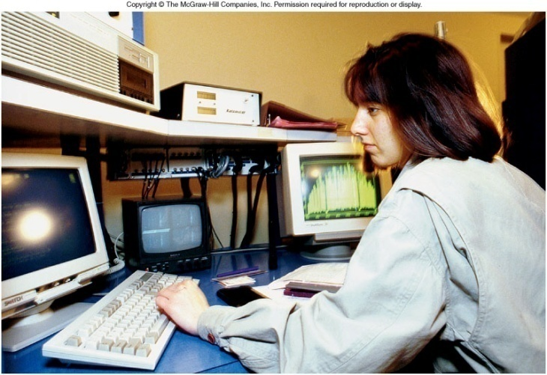
Computers and Astronomy
For many astronomers, operating a computer and being able to program are more important than knowing how to use a telescope
Computers accomplish several tasks:
Solve equations
Move telescopes and
feed information to detectors
Convert data into useful form
Networks for communication
and data exchange

Slide 27
Scintillation
Refraction is also responsible for seeing
Twinkling of stars
AKA Scintillation
Temperature and density differences in pockets of air shift the image of the star

Slide 28
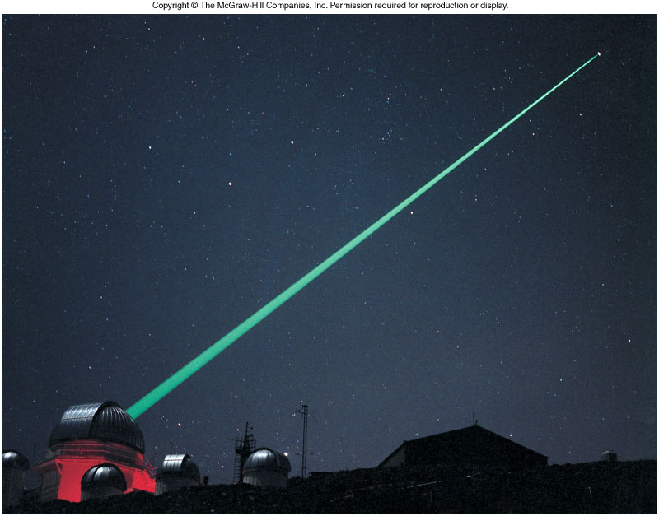
Atmospheric Blurring
The condition of the sky for viewing is referred to as the seeing
Distorted seeing can be improved by adaptive optics, which employs a powerful laser and correcting mirrors to offset scintillation
Many telescopes are built in high-altitude, dry environments to reduce scintillation.

Slide 29
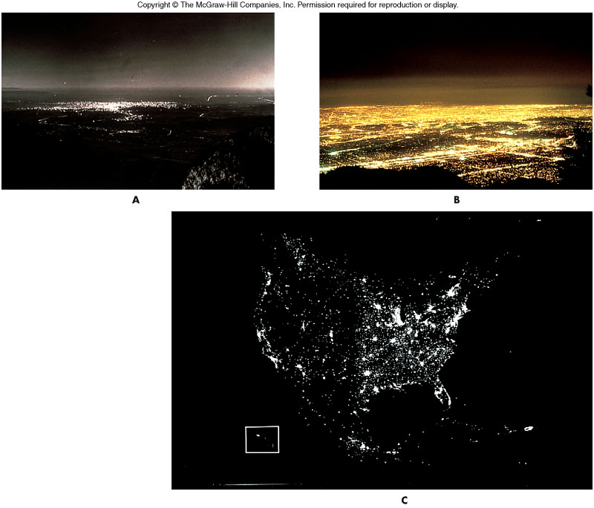
Light Pollution

