Slide 1
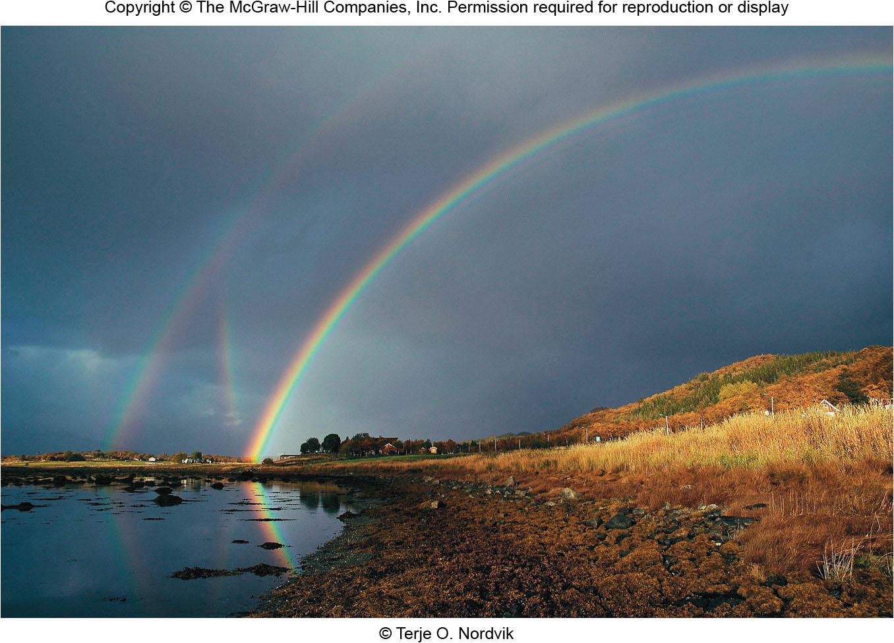
Chapter 4
Light and Atoms
Copyright © McGraw-Hill Education. Permission required for reproduction or display.

Slide 2
Light – the Astronomer’s Tool
Due to the vast distances, with few exceptions, direct measurements of astronomical bodies are not possible
We study remote bodies indirectly by analyzing their light
Understanding the properties of light is therefore essential
Care must be given to distinguish light signatures that belong to the distant body from signatures that do not (e.g., our atmosphere may distort distant light signals)

Slide 3
Properties of Light
Light is radiant energy: it does not require a medium for travel (unlike sound!)
Light travels at 299,792.458 km/s in a vacuum (fast enough to circle the Earth 7.5 times in one second)
Speed of light in a vacuum is constant and is denoted by the letter “c”
However, the speed of light is reduced as it passes through transparent materials
The speed of light in transparent materials is dependent on color
Fundamental reason telescopes work the way they do!

Slide 4
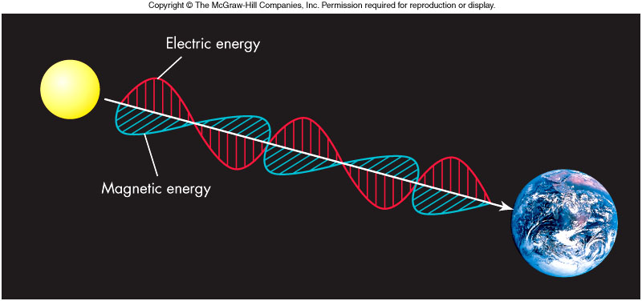
Sometimes light can be modeled as a wave…
The wave travels as a result of a fundamental relationship between electricity and magnetism
A changing magnetic field creates an electric field and a changing electric field creates a magnetic field

Slide 5
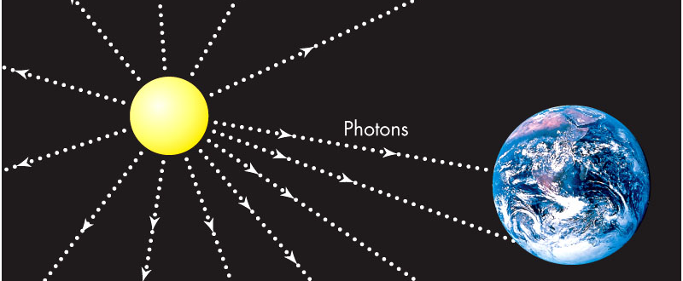
…and sometimes it can be modeled as a particle!
Light thought of as a stream of particles called photons
Each photon particle carries energy, depending on its frequency or wavelength

Slide 6
So which model do we use?
Well, it depends!
In a vacuum, photons travel in straight lines, but behave like waves
Sub-atomic particles also act as waves
Wave-particle duality: All particles of nature behave as both a wave and a particle
The model we use to describe light’s behavior depends on the situation
We concentrate on the wave picture henceforth

Slide 7
Light and Color
Colors to which the human eye is sensitive is referred to as the visible spectrum
In the wave theory, color is determined by the light’s wavelength (symbolized as λ)
The nanometer (10⁻⁹ m) is the convenient unit
Red = 700 nm (longest visible wavelength), violet = 400 nm (shortest visible wavelength)

Slide 8
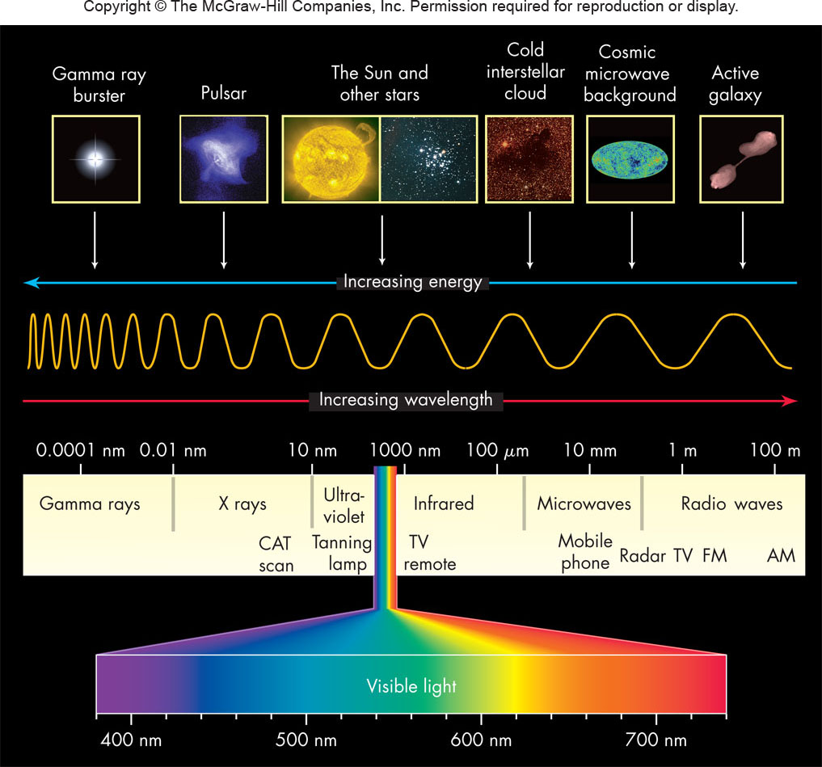
The Visible Spectrum

Slide 9
Frequency
Sometimes it is more convenient to talk about light’s frequency
Frequency (or ν) is the number of wave crests that pass a given point in 1 second (measured in Hertz, Hz)
Important relation: νλ = c
Long wavelength = low frequency
Short wavelength = high frequency

Slide 10
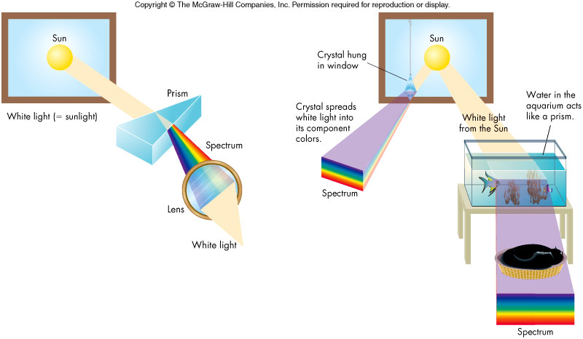
White light – a mixture of all colors
A prism demonstrates that white light is a mixture of wavelengths by its creation of a spectrum
Additionally, one can recombine a spectrum of colors and obtain white light

Slide 11
The Electromagnetic Spectrum
The electromagnetic spectrum is composed of radio waves, microwaves, infrared, visible light, ultraviolet, x rays, and gamma rays
Longest wavelengths are more than 10³ km
Shortest wavelengths are less than 10⁻¹⁸ m
Various instruments used to explore the various regions of the spectrum

Slide 12
Infrared Radiation
Sir William Herschel (around 1800) showed heat radiation related to visible light
He measured an elevated temperature just off the red end of a solar spectrum – infrared energy
Our skin feels infrared as heat

Slide 13
Ultraviolet Light
J. Ritter in 1801 noticed silver chloride blackened when exposed to “light” just beyond the violet end of the visible spectrum
Mostly absorbed by the atmosphere
Responsible for suntans (and burns!)

Slide 14
Radio Waves
Predicted by Maxwell in mid-1800s, Hertz produced radio waves in 1888
Jansky discovered radio waves from cosmic sources in the 1930s, the birth of radio astronomy
Radio waves used to study a wide range of astronomical processes
Radio waves also used for communication, microwave ovens, and search for extraterrestrials

Slide 15
X-Rays
Roentgen discovered X rays in 1895
First detected beyond the Earth in the Sun in late 1940s
Used by doctors to scan bones and organs
Used by astronomers to detect black holes and tenuous gas in distant galaxies

Slide 16
Gamma Rays
Gamma Ray region of the spectrum still relatively unexplored
Atmosphere absorbs this region, so all observations must be done from orbit!
We sometimes see bursts of gamma ray radiation from deep space

Slide 17
Energy Carried by Electromagnetic Radiation
Each photon of wavelength λ carries an energy E given by:
E = hc/λ
where h is Planck’s constant
Notice that a photon of short wavelength radiation carries more energy than a long wavelength photon
Short wavelength = high frequency = high energy
Long wavelength = low frequency = low energy

Slide 18
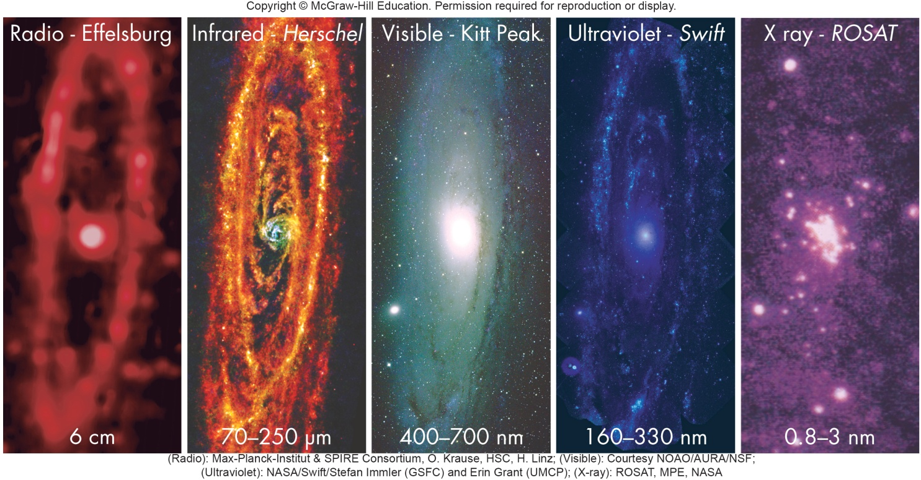
Different Wavelengths, Different Science
We see different phenomena in different wavelengths.
Visible light shows the distribution of stars.
Infrared reveals dust in the galaxy.
X-rays reveal supernovae, etc.

Slide 19
Matter and Heat
The Nature of Matter and Heat
The ancient Greeks introduced the idea of the atom (Greek for “uncuttable”), which today has been modified to include a nucleus and a surrounding cloud of electrons
Heating (transfer of energy) and the motion of atoms was an important topic in the 1700s and 1800s

Slide 20
A New View of Temperature
The Kelvin Temperature Scale
An object’s temperature is directly related to its energy content and to the speed of molecular motion
As a body is cooled to zero Kelvin, molecular motion within it slows to a virtual halt and its energy approaches zero ⇒ no negative temperatures
Fahrenheit and Celsius are two other temperature scales that are easily converted to Kelvin

Slide 21
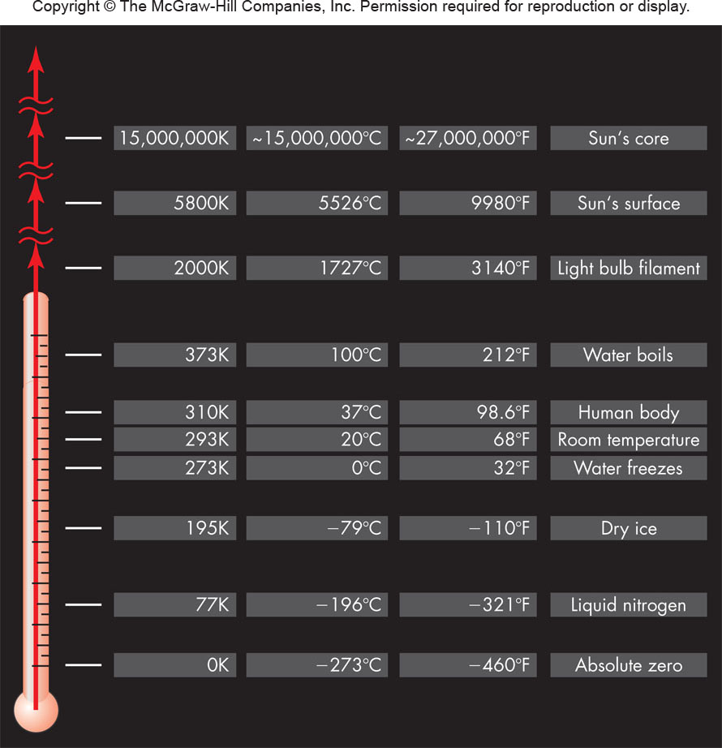
The Kelvin Temperature Scale

Slide 22
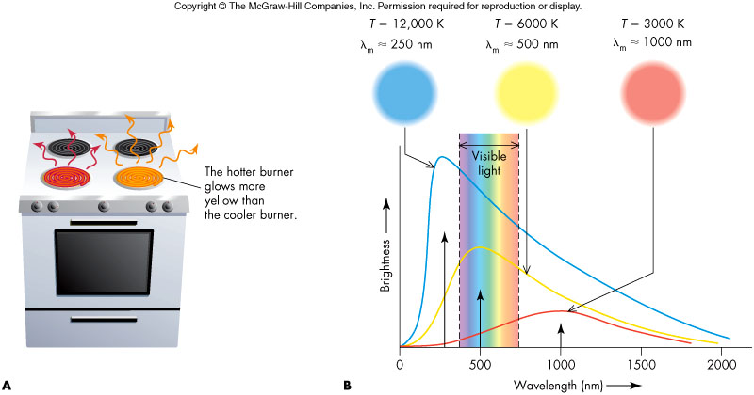
Wien’s Law
Heated bodies generally radiate across the entire electromagnetic spectrum
There is one particular wavelength, λ_{m}, at which the radiation is most intense and is given by Wien’s Law:
λ_{m} = k/T
where k is some constant and T is the temperature of the body

Slide 23
Radiation and Temperature
Note hotter bodies radiate more strongly at shorter wavelengths
As an object heats, it appears to change color from red to white to blue
Measuring λ_{m} gives a body’s temperature
Careful: Reflected light does not give the temperature

Slide 24
Ideal Blackbodies
A blackbody is an object that absorbs all the radiation falling on it
Since such an object does not reflect any light, it appears black when cold, hence its name
As a blackbody is heated, it radiates more efficiently than any other kind of object
Blackbodies are excellent absorbers and emitters of radiation and follow Wien’s law
Very few real objects are perfect blackbodies, but many objects (e.g., the Sun and Earth) are close approximations
Gases, unless highly compressed, are not blackbodies and can only radiate in narrow wavelength ranges

Slide 25
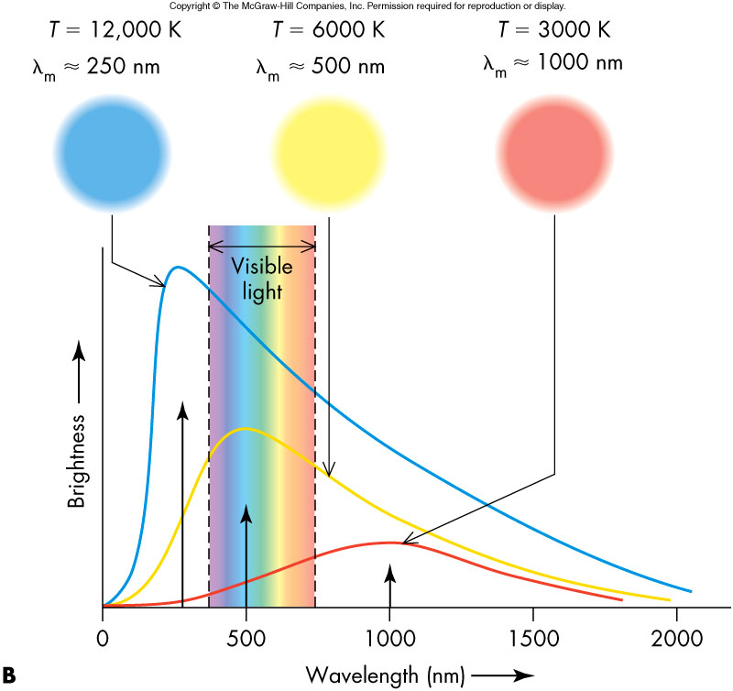
Blackbodies and Wien’s Law

Slide 26
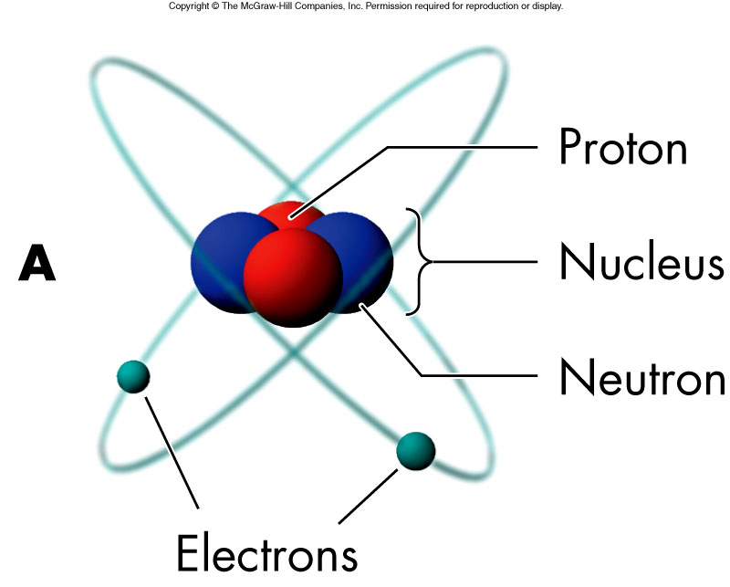
The Chemical Elements
An element is a substance composed only of atoms that have the same number of protons in their nucleus
A neutral element will contain an equal number of protons and electrons
The chemical properties of an element are determined by the number of electrons

Slide 27
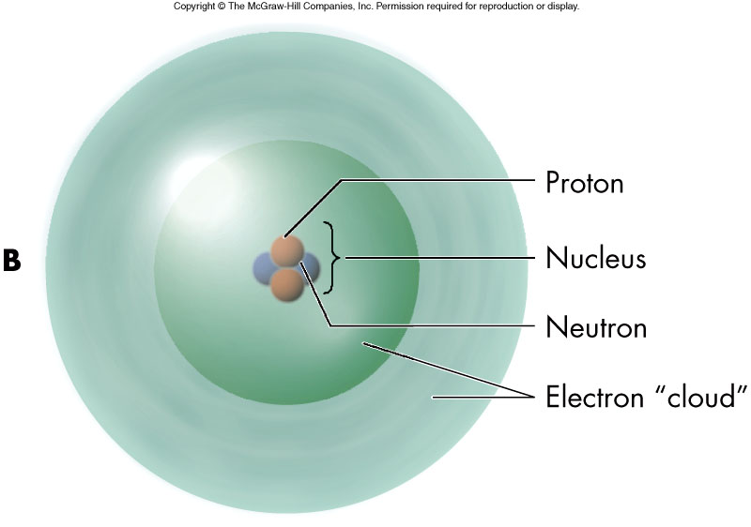
The Structure of Atoms
Nucleus – Composed of densely packed neutrons and positively charged protons
Orbitals - Clouds of negative electrons held around nucleus by positive charge of protons
Typical atom size: 10⁻¹⁰ m (= 1 Å = 0.1 nm)

Slide 28
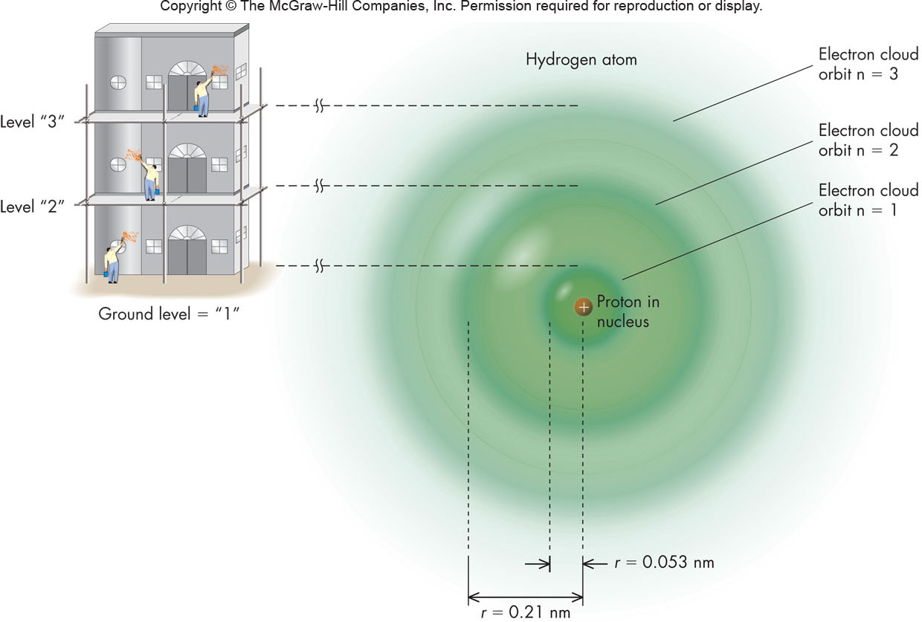
Electron Orbitals
The electron orbitals are quantized, can only have discrete values and nothing in between
Quantized orbitals are the result of the wave-particle duality of matter
As electrons move from one orbital to another, they change their energy in discrete amounts

Slide 29
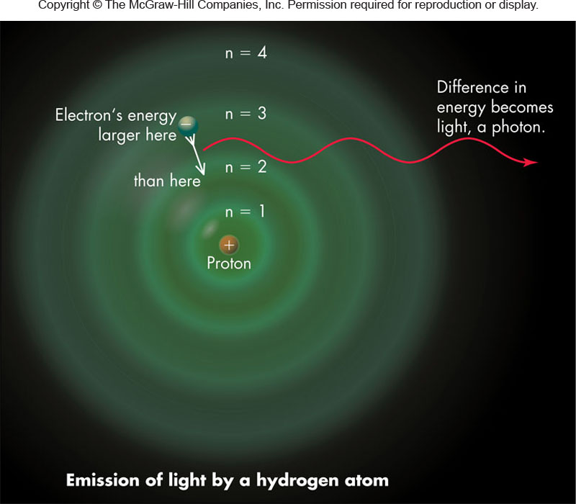
Energy Change in an Atom
An atom’s energy is increased if an electron moves to an outer orbit – the atom is said to be excited
An atom’s energy is decreased if an electron moves to an inner orbit

Slide 30
Conservation of Energy
The energy change of an atom must be compensated elsewhere – Conservation of Energy
Absorption and emission of EM radiation are two ways to preserve energy conservation
In the photon picture, a photon is absorbed as an electron moves to a higher orbit and a photon is emitted as an electron moves to a lower orbit

Slide 31
Emission

Slide 32
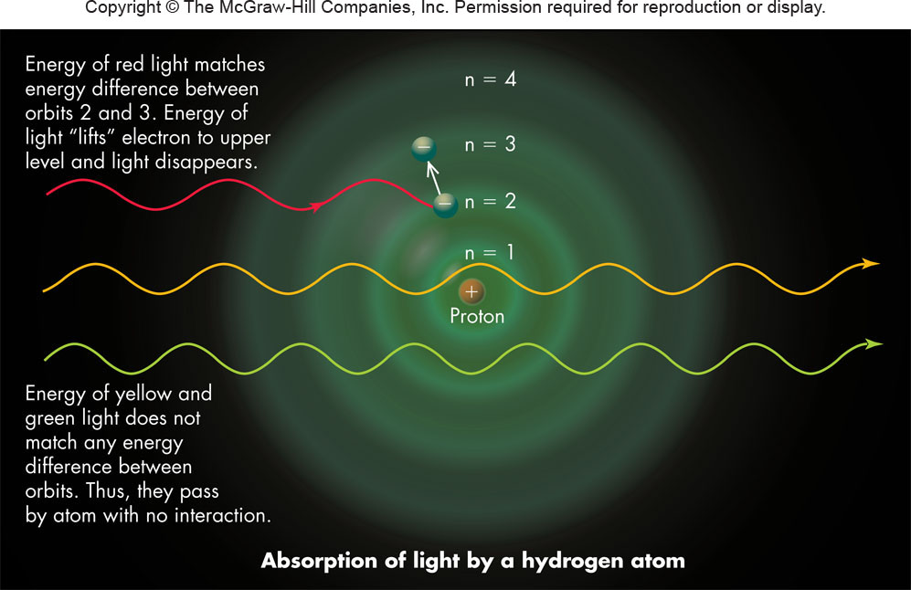
Absorption

Slide 33
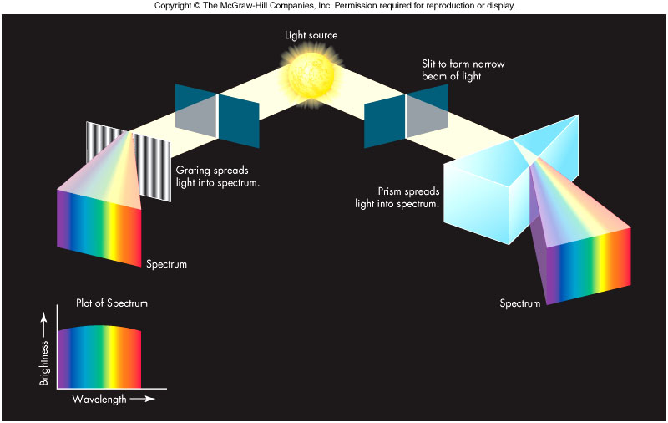
Spectroscopy
Allows the determination of the composition and conditions of an astronomical body
In spectroscopy, we capture and analyze a spectrum
Spectroscopy assumes that every atom or molecule will have a unique spectral signature

Slide 34
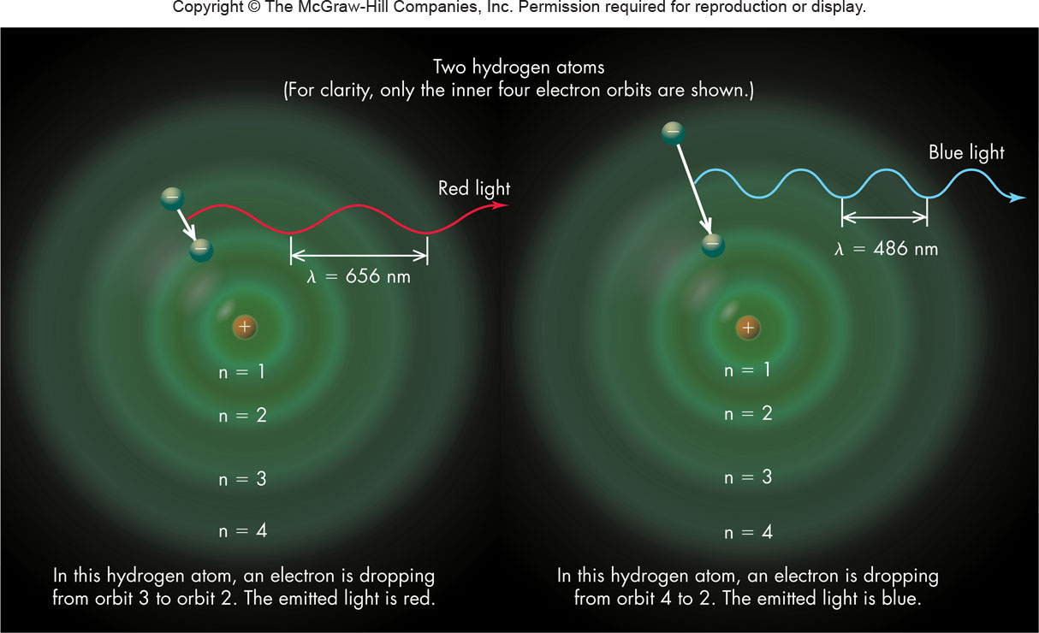
Formation of a Spectrum
Key Point: A transition in energy level produces or absorbs a photon

Slide 35
Types of Spectra
Continuous spectrum
Spectra of a blackbody
Typical objects are solids and dense gases
Emission-line spectrum
Produced by hot, tenuous gases
Fluorescent tubes, aurora, and many interstellar clouds are typical examples
Dark-line or absorption-line spectrum
Light from blackbody passes through cooler gas leaving dark absorption lines
Fraunhofer lines of Sun are an example

Slide 36
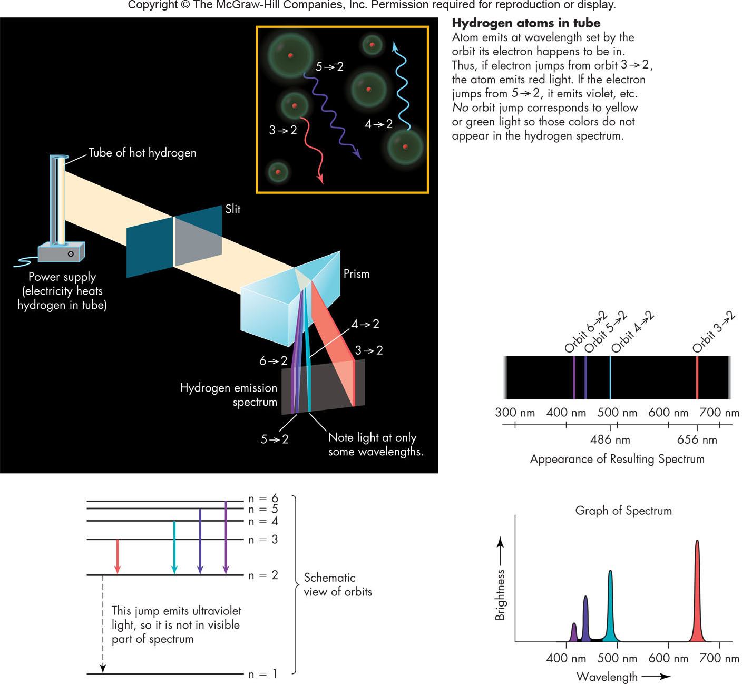
Hydrogen Emission Spectrum

Slide 37
Helium Emission Spectrum

Slide 38
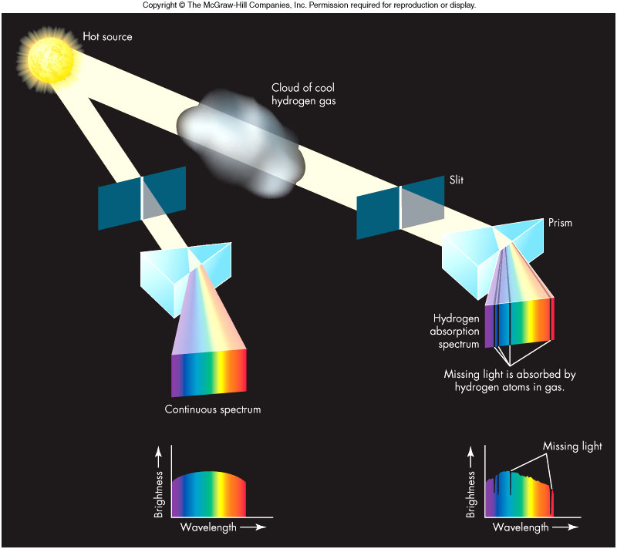
Continuous and Absorption Spectra

Slide 39
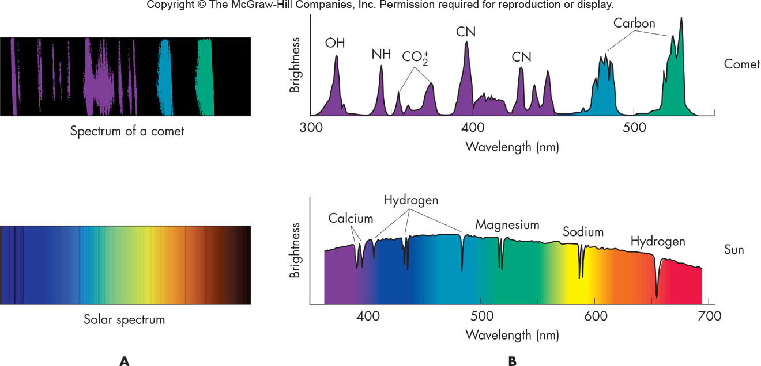
Astronomical Spectra

Slide 40
Absorption in the Atmosphere
Gases in the Earth’s atmosphere absorb electromagnetic radiation to the extent that most wavelengths from space do not reach the ground
Visible light, most radio waves, and some infrared penetrate the atmosphere through atmospheric windows, wavelength regions of high transparency
Lack of atmospheric windows at other wavelengths is the reason for astronomers placing telescopes in space

Slide 41
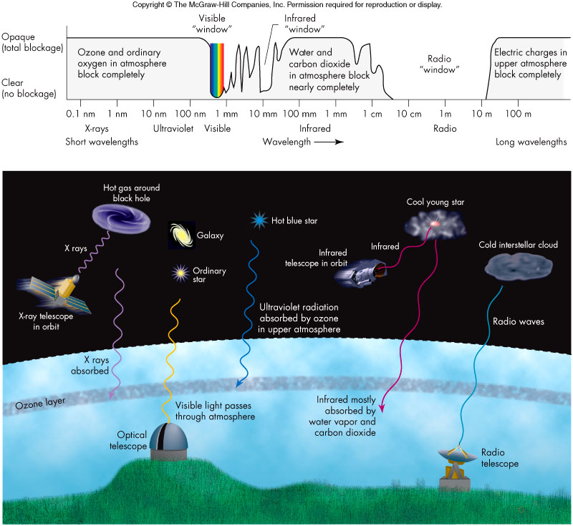
Atmospheric Windows

Slide 42
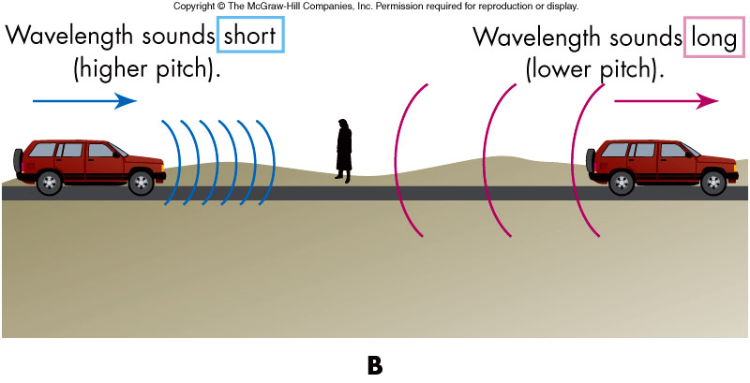
Doppler Shift in Sound
If the source of sound is moving, the pitch changes!

Slide 43
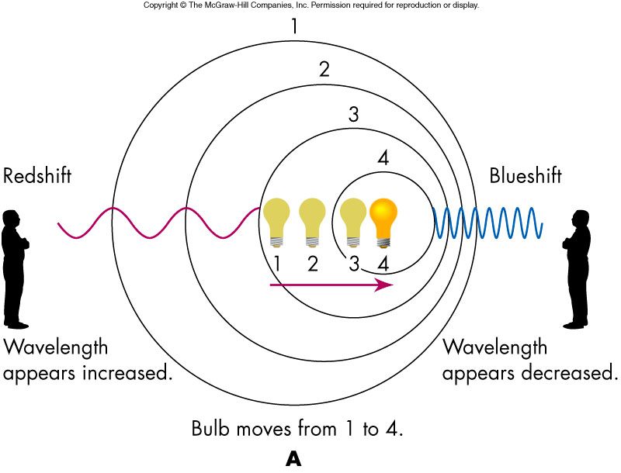
Doppler Shift in Light
The shift in wavelength is given as
Δλ = λ – λ_{o} = λ_{o}v/c
where λ is the observed (shifted) wavelength, λ_{o} is the emitted wavelength, v is the source non-relativistic radial velocity, and c is the speed of light
If a source of light is set in motion relative to an observer, its spectral lines shift to new wavelengths in a similar way

Slide 44
Redshift and Blueshift
An observed increase in wavelength is called a redshift, and a decrease in observed wavelength is called a blueshift (regardless of whether or not the waves are visible)
Doppler shift is used to determine an object’s velocity

