Slide 1
ASTRO UNIT 1 REVIEW

Slide 2
RQ 1
What is the point directly over head called?

Slide 3
RQA 1
Zenith

Slide 4
RQ 2
The angular distance from the horizon up to a point in the sky is called?

Slide 5
RQA 2
Altitude

Slide 6
RQ 3
What is the altitude of the zenith?

Slide 7
RQA 3
90 degrees

Slide 8
RQ 4
Why does the sun appear to rise and set in the sky?

Slide 9
RQA 4
Because the Earth rotates on its axis.

Slide 10
RQ 5
Why does the sun appear to rise and set in the sky?

Slide 11
RQA 5
Because the Earth rotates on its axis.

Slide 12
RQ 6
What is the general motion of the stars at night?

Slide 13
RQA 6
East to West

Slide 14
RQ 7
If you were standing at the Earth’s equator, where will you find Polaris?

Slide 15
RQA 7
On the horizon in the North

Slide 16
RQ 8
What instrument can be used to measure altitude of Polaris?

Slide 17
RQA 8
Astrolabe

Slide 18
RQ 9
The edge of the sky that appears to touch the land is known as?

Slide 19
RQA 9
Horizon

Slide 20
RQ 10
If you observed an object in the sky and needed to record your findings what coordinates will you need?

Slide 21
RQA 10
Right ascension and Declination

Slide 22
RQ 11
If you were at the North Pole where will Polaris be?

Slide 23
RQA 11
Directly overhead

Slide 24
RQ 12
If you are standing in Atlanta looking westward and you see Venus just above the horizon at sunset, where will Venus be in 6 hours?

Slide 25
RQA 12
Not visible

Slide 26
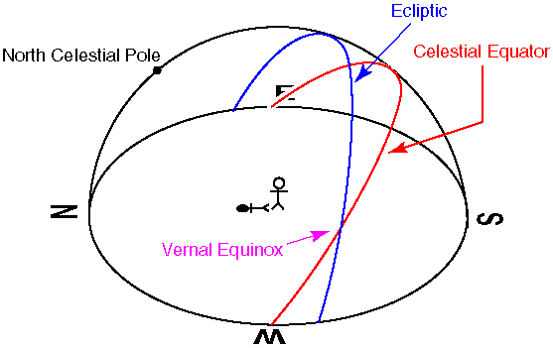
RQ 13
In the diagram the sun is shown at noon on September 21, where will the sun’s altitude position be at noon 2 month’s from now?

Slide 27
RQA 13
The altitude of the sun will be lower

Slide 28
RQ 14
How much shorter is a sidereal day than a solar day?

Slide 29
RQA 14
4 minutes

Slide 30
RQ 15
If a star rises at 11pm tonight, what time will it rise one month from now?

Slide 31
RQA 15
9 pm

Slide 32
RQ 16
The Sun’s path on the celestial sphere is known as?

Slide 33
RQA 16
Ecliptic

Slide 34
RQ 17
If you viewed Polaris from Alaska which is located at a 60 degree latitude, how high above the horizon will you find Polaris?

Slide 35
RQA 17
60 degrees

Slide 36
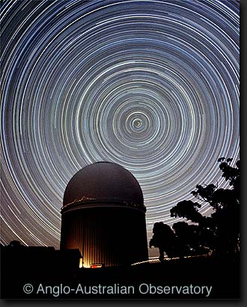
RQ 18
What are the circles in the picture?

Slide 37
RQA 18
Diurnal Circles

Slide 38
RQ 19
These diurnal circles are what?

Slide 39
RQA 19
Circumpolar Stars

Slide 40
RQ 20
What object is in the middle of this picture?

Slide 41
RQA 20
Polaris

Slide 42
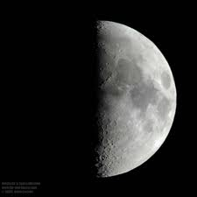
RQ 21
What is the name of the moon phase in the image?

Slide 43
RQA 21
1st Quarter Moon

Slide 44
RQ 22
An observer in the southern hemisphere sees the Sun at the zenith at noon on which day?

Slide 45
RQA 22
December 21

Slide 46
RQ 23
If you are looking at the night sky, the planets and the Moon appear to line up where?

Slide 47
RQA 23
Near the ecliptic

Slide 48
RQ 24
When it is winter in the northern hemisphere what season will it be in the southern hemisphere?

Slide 49
RQA 24
Summer

Slide 50
RQ 25
In Atlanta, in which month do you see the sun at its highest altitude?

Slide 51
RQA 26
June

Slide 52
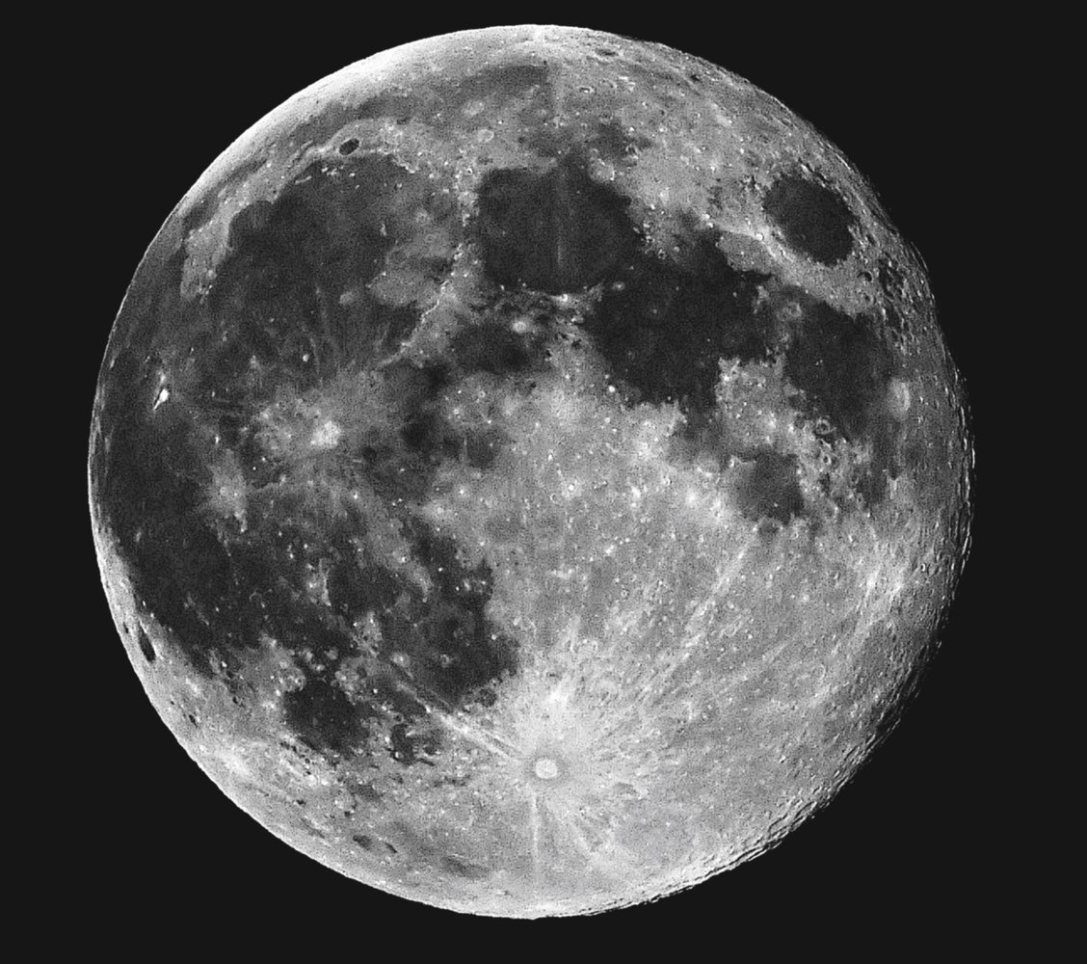
RQ 27
What Moon phase is shown in the picture?

Slide 53
RQA 27
Full Moon

Slide 54
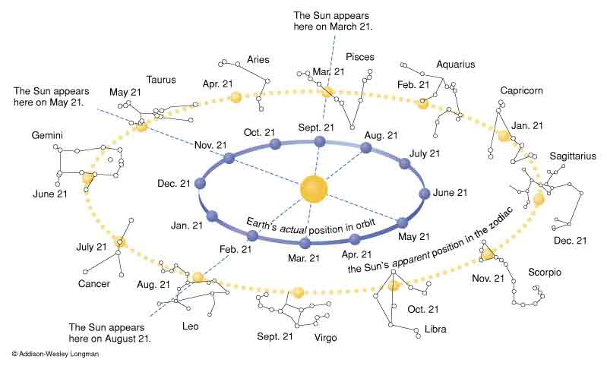
RQ 28
In the diagram, which constellation will not be visible at night in September?
Aries, Leo, Pisces, Sagittarius

Slide 55
RQA 28
Leo

Slide 56
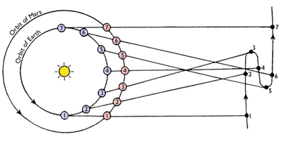
RQ 29
During which months does Mars appear in retrograde?

Slide 57
RQA 29
4,5,6

Slide 58
RQ 30
Why does the Moon appear to go through phases?

Slide 59
RQA 30
Because we see the moon from different angles, so we see a portion of the lit side.

Slide 60
RQ 31
When does a lunar eclipse occur?

Slide 61
RQA 31
When the Earth is between the Moon and the Sun

Slide 62
RQ 32
When does a solar eclipse occur?

Slide 63
RQA 32
When the Moon’s shadow falls on the Earth

Slide 64
RQ 33
What phase must the Moon be in for a solar eclipse to occur?

Slide 65
RQA 33
New Moon

Slide 66
RQ 34
What phase must the Moon be in for a lunar eclipse to occur?

Slide 67
RQA 34
Full Moon

Slide 68
RQ 35
Approximately how many days does it take the Moon to go around the Earth?

Slide 69
RQA 35
28 days

Slide 70
RQ 36
Which of the following stay in fixed locations on the celestial sphere?
Moon
Planets
Sun
Stars

Slide 71
RQA 36
Stars

Slide 72
RQ 37
Zodiac constellations are not all seen at the same times over the course of the year because why?

Slide 73
RQA 37
Some of the constellations are up during the day when the sun is up

Slide 74
RQ 38
Approximately how many days does it take the Earth to orbit the Sun?

Slide 75
RQA 38
1 year

