Slide 1
ELECTRON CONFIGURATION

Slide 2
The Periodic Table

Slide 3
Valence Electrons

Slide 4
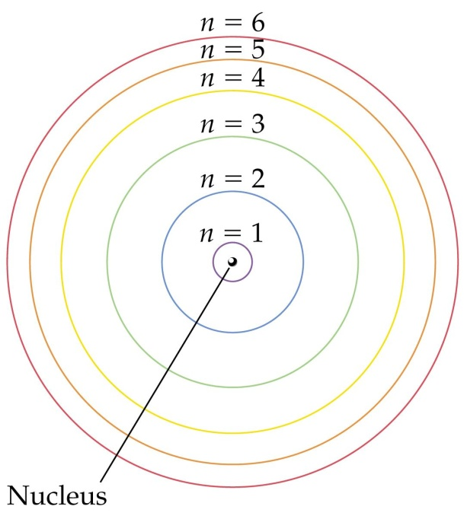
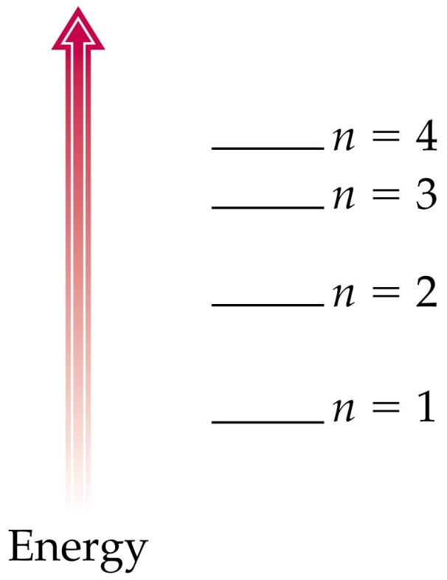
Quantum Theory and the Atom
Neils Bohr Atomic Model
Described the atom as electrons moving around the nucleus in well defined orbits .
The smaller the orbit, the lower the energy.
The larger the orbit, the higher the energy.
-n=1, n=2, n=3, n=4
Ground State
the lowest allowable energy state of an atom

Slide 5
Principle Energy Levels
Principal Energy Levels
-( n = 1 through 7 )
Sublevels
-( s. p. d. f )
Orbitals
-s = 2 electrons
-p = 6 electrons
-d = 10 electrons
-f = 14 electrons

Slide 6
Electron Configuration
The arrangement of electrons in an atom.
-s =1 orbital
(maximum of 2 electrons )
-p = 3 orbitals
(maximum of 6 electrons)
-d = 5 orbitals
(maximum of 10 electrons)
-f = 7 orbitals
(maximum of 14 electrons)

Slide 7
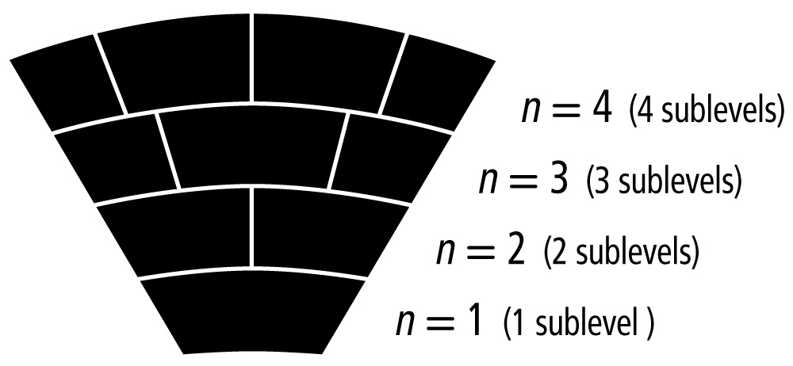
Atomic Orbitals
Energy sublevels are contained within the principal energy levels.

Slide 8
Atomic Orbitals
Each energy sublevel relates to orbitals of different shape.
s, p, d, f
s, p, d
s, p
s

Slide 9
ORBITAL SHAPES

Slide 10
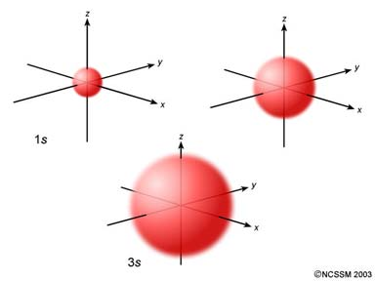
Atomic Orbitals
s sublevel:

Slide 11
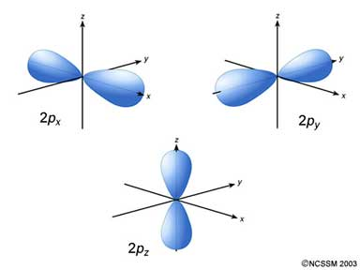
Atomic Orbitals
p sublevel:

Slide 12
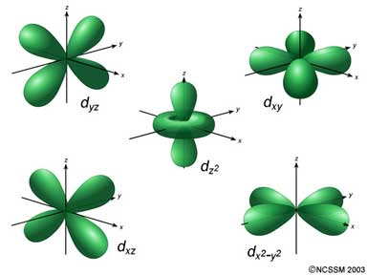
Atomic Orbitals
d sublevel:

Slide 13
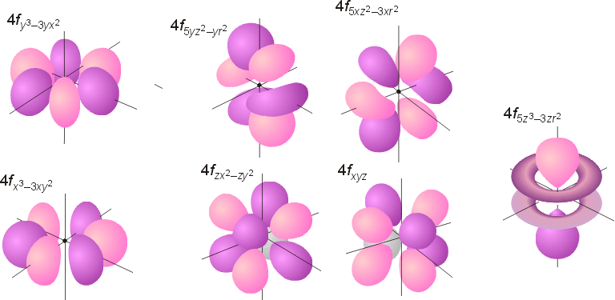
Atomic Orbitals
f sublevel:

Slide 15
RULES FOR FILLING ENERGY LEVELS

Slide 16
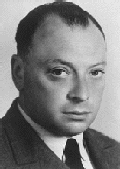
General Rules
Pauli Exclusion Principle
Each orbital can hold TWO electrons with opposite spins.
Wolfgang Pauli
Courtesy Christy Johannesson www.nisd.net/communicationsarts/pages/chem

Slide 17
General Rules
6d
Aufbau Principle
Electrons fill the lowest energy orbitals first.
“Lazy Tenant Rule”
7s
5f
6d
6p
7s
5f
5d
4f
6p
6s
5d
5p
6s
4f
4d
5s
5p
4p
5s
4d
4s
3d
4p
3p
4s
3d
Energy
3s
3p
3s
2p
2s
2p
2s
1s
1s
Courtesy Christy Johannesson www.nisd.net/communicationsarts/pages/chem

Slide 18
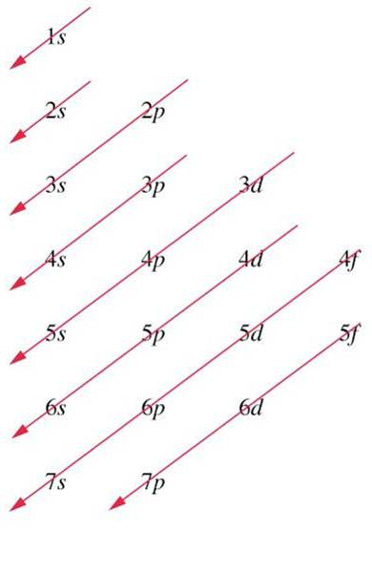
AUFBAU FILLING ORDER

Slide 19
General Rules
Hund’s Rule
Within a sublevel, place one electron per orbital before pairing them.
“Empty Bus Seat Rule”
WRONG
RIGHT
Courtesy Christy Johannesson www.nisd.net/communicationsarts/pages/chem

Slide 20
Energy Level Diagram of a Many-Electron Atom
6s 6p 5d 4f
32
5s 5p 4d
18
4s 4p 3d
Arbitrary
Energy Scale
18
3s 3p
8
2s 2p
8
1s
2
NUCLEUS
O’Connor, Davis, MacNab, McClellan, CHEMISTRY Experiments and Principles 1982, page 177

Slide 21
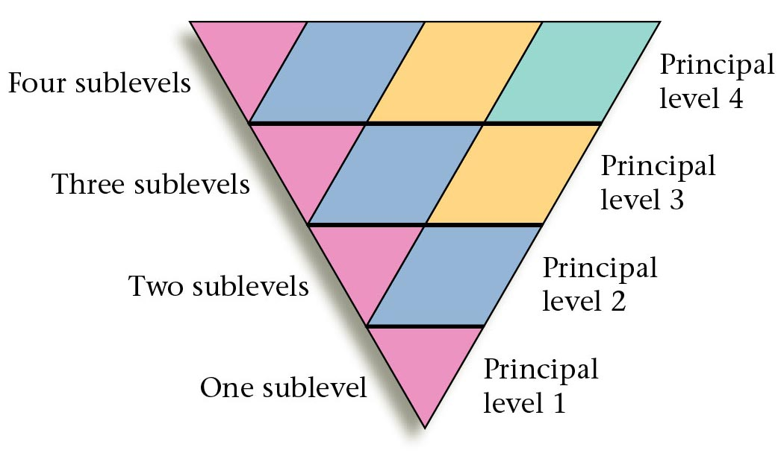
4f
Sublevels
4d
n = 4
4p
3d
4s
6d
5f
n = 3
3p
7s
6d
5f
Energy
6p
7s
5d
6p
4f
6s
5d
4f
5p
6s
4d
5p
3s
5s
4d
4p
5s
3d
4p
4s
3d
Energy
3p
4s
3s
3p
2p
2p
3s
2s
2p
n = 2
2s
2s
1s
1s
1s
n = 1
Notes:
The energy of an electron is determined by its average distance from the nucleus.
Each atomic orbital with a given set of quantum numbers has a particular energy associated with it, the orbital energy.
In atoms or ions that contain only a single electron, all orbitals with the same value of n have the same energy (they are degenerate).
Energies of the principal shells increase smoothly as n increases.
An atom or ion with the electron(s) in the lowest-energy orbital(s) is said to be in the ground state; an atom or ion in which one or more electrons occupy higher-energy orbitals is said to be in the excited state.

Slide 22
4f
Sublevels
4d
s
p
d
f
n = 4
s
p
d
4p
s
p
3d
s
4s
n = 3
3p
Energy
3s
1s²2s²2p⁶3s²3p⁶4s²3d¹⁰4p⁶5s²4d¹⁰…
2p
n = 2
2s
n = 1
1s
Notes:
Electron configuration of an element is the arrangement of its electrons in its atomic orbitals
One can obtain and explain a great deal of the chemistry of the element by knowing its electron configuration

Slide 23
Periodic Patterns
Example - Hydrogen
1s¹
1st column of s-block
1st Period
s-block
Courtesy Christy Johannesson www.nisd.net/communicationsarts/pages/chem

Slide 24
Periodic Patterns
s
p
1
2
3
4
5
6
7
1s
1s
2s
2p
d (n-1)
3s
3p
4s
3d
4p
5s
4d
5p
6s
5d
6p
7s
6d
7p
6
7
4f
f (n-2)
5f

Slide 25
ELECTRON FILLING ORDER PATTERN
For elements 1-38
1s2s2p3s3p4s3d4p5s

Slide 26
Energy Level Diagram
6s 6p 5d 4f
Bohr Model
5s 5p 4d
4s 4p 3d
Arbitrary Energy Scale
3s 3p
N
2s 2p
1s
Electron Configuration
NUCLEUS
H He Li C N Al Ar F Fe La
CLICK ON ELEMENT TO FILL IN CHARTS

Slide 27
Energy Level Diagram
Hydrogen
6s 6p 5d 4f
Bohr Model
5s 5p 4d
4s 4p 3d
Arbitrary Energy Scale
3s 3p
N
2s 2p
1s
Electron Configuration
NUCLEUS
H = 1s¹
H He Li C N Al Ar F Fe La
CLICK ON ELEMENT TO FILL IN CHARTS

Slide 28
Energy Level Diagram
Helium
6s 6p 5d 4f
Bohr Model
5s 5p 4d
4s 4p 3d
Arbitrary Energy Scale
3s 3p
N
2s 2p
1s
Electron Configuration
NUCLEUS
He = 1s²
H He Li C N Al Ar F Fe La
CLICK ON ELEMENT TO FILL IN CHARTS

Slide 29
Energy Level Diagram
Lithium
6s 6p 5d 4f
Bohr Model
5s 5p 4d
4s 4p 3d
Arbitrary Energy Scale
3s 3p
N
2s 2p
1s
Electron Configuration
NUCLEUS
Li = 1s²2s¹
H He Li C N Al Ar F Fe La
CLICK ON ELEMENT TO FILL IN CHARTS

Slide 30
Energy Level Diagram
Carbon
6s 6p 5d 4f
Bohr Model
5s 5p 4d
4s 4p 3d
Arbitrary Energy Scale
3s 3p
N
2s 2p
1s
Electron Configuration
NUCLEUS
C = 1s²2s²2p²
H He Li C N Al Ar F Fe La
CLICK ON ELEMENT TO FILL IN CHARTS

Slide 31
Energy Level Diagram
Nitrogen
6s 6p 5d 4f
Bohr Model
5s 5p 4d
4s 4p 3d
Arbitrary Energy Scale
3s 3p
N
Hund’s Rule “maximum
number of unpaired orbitals”.
2s 2p
1s
Electron Configuration
NUCLEUS
N = 1s²2s²2p³
H He Li C N Al Ar F Fe La
CLICK ON ELEMENT TO FILL IN CHARTS

Slide 32
Energy Level Diagram
Fluorine
6s 6p 5d 4f
Bohr Model
5s 5p 4d
4s 4p 3d
Arbitrary Energy Scale
3s 3p
N
2s 2p
1s
Electron Configuration
NUCLEUS
F = 1s²2s²2p⁵
H He Li C N Al Ar F Fe La
CLICK ON ELEMENT TO FILL IN CHARTS

Slide 33
Energy Level Diagram
Aluminum
6s 6p 5d 4f
Bohr Model
5s 5p 4d
4s 4p 3d
Arbitrary Energy Scale
3s 3p
N
2s 2p
1s
Electron Configuration
NUCLEUS
Al = 1s²2s²2p⁶3s²3p¹
H He Li C N Al Ar F Fe La
CLICK ON ELEMENT TO FILL IN CHARTS

Slide 34
Energy Level Diagram
Argon
6s 6p 5d 4f
Bohr Model
5s 5p 4d
4s 4p 3d
Arbitrary Energy Scale
3s 3p
N
2s 2p
1s
Electron Configuration
NUCLEUS
Ar = 1s²2s²2p⁶3s²3p⁶
H He Li C N Al Ar F Fe La
CLICK ON ELEMENT TO FILL IN CHARTS

Slide 35
Energy Level Diagram
Iron
6s 6p 5d 4f
Bohr Model
5s 5p 4d
4s 4p 3d
Arbitrary Energy Scale
3s 3p
N
2s 2p
1s
Electron Configuration
NUCLEUS
Fe = 1s²2s²2p⁶3s²3p⁶4s²3d⁶
H He Li C N Al Ar F Fe La
CLICK ON ELEMENT TO FILL IN CHARTS

Slide 36
Energy Level Diagram
Lanthanum
6s 6p 5d 4f
Bohr Model
5s 5p 4d
4s 4p 3d
Arbitrary Energy Scale
3s 3p
N
2s 2p
1s
Electron Configuration
NUCLEUS
La = 1s²2s²2p⁶3s²3p⁶4s²3d¹⁰
4s²3d¹⁰4p⁶5s²4d¹⁰5p⁶6s²5d¹
H He Li C N Al Ar F Fe La
CLICK ON ELEMENT TO FILL IN CHARTS

Slide 37
STOP AND PRACTICE
GO TO THE LINK ON YOUR CTLS AND COMPLETE ASSIGNMENT #8

Slide 38
ELECTRON CONFIGURATION SHORTHAND

Slide 39
Notation
8
O
15.9994
Orbital Diagram
O
8e⁻
1s
2s
2p
Electron Configuration
1s² 2s² 2p⁴
Courtesy Christy Johannesson www.nisd.net/communicationsarts/pages/chem

Slide 40
Periodic Patterns
Shorthand Configuration
Core electrons:
Go up one row and over to the Noble Gas.
Valence electrons:
On the next row, fill in the # of e⁻ in each sublevel.
p
s
d (n-1)
f (n-2)
Courtesy Christy Johannesson www.nisd.net/communicationsarts/pages/chem

Slide 41
Notation
16
S
32.066
Longhand Configuration
S 16e⁻
1s²
2s²
2p⁶
3s²
3p⁴
Core Electrons
Valence Electrons
Shorthand Configuration
S 16e⁻ [Ne] 3s² 3p⁴
Courtesy Christy Johannesson www.nisd.net/communicationsarts/pages/chem

Slide 42
Periodic Patterns
32
Ge
72.61
Example - Germanium
[Ar]
4s²
3d¹⁰
4p²
Courtesy Christy Johannesson www.nisd.net/communicationsarts/pages/chem

Slide 43
Shorthand Configuration
Element symbol
Electron configuration
Ca
[Ar] 4s²
V
[Ar] 4s² 3d³
F
[He] 2s² 2p⁵
Ag
[Kr] 5s² 4d⁹
I
[Kr] 5s² 4d¹⁰ 5p⁵
Xe
[Kr] 5s² 4d¹⁰ 5p⁶
Fe
[He] 2s²2p⁶3s²3p⁶4s²3d⁶
[Ar] 4s²3d⁶
Sg
[Rn] 7s² 5f¹⁴ 6d⁴

Slide 44
The Octet Rule
Atoms tend to gain, lose, or share electrons
until they have eight valence electrons.
This fills the valence
shell and tends to give
the atom the stability
of the inert gasses.
8
ONLY s- and p-orbitals are valence electrons.

Slide 45
Stability
Full energy level
Full sublevel (s, p, d, f)
Half-full sublevel
Courtesy Christy Johannesson www.nisd.net/communicationsarts/pages/chem

Slide 46
Stability
Electron Configuration Exceptions
Copper
EXPECT: [Ar] 4s² 3d⁹
ACTUALLY: [Ar] 4s¹ 3d¹⁰
Copper gains stability with a full d-sublevel.
Courtesy Christy Johannesson www.nisd.net/communicationsarts/pages/chem

Slide 47
Stability
Electron Configuration Exceptions
Chromium
EXPECT: [Ar] 4s² 3d⁴
ACTUALLY: [Ar] 4s¹ 3d⁵
Chromium gains stability with a half-full d-sublevel.
Courtesy Christy Johannesson www.nisd.net/communicationsarts/pages/chem

Slide 48
REVIEW

Slide 49
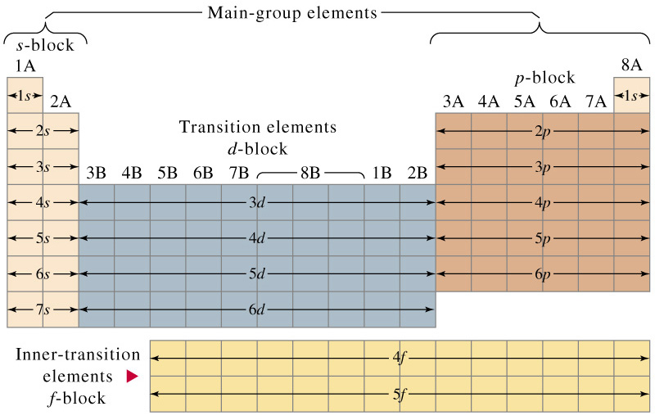
Electron Configuration using the Periodic Table

Slide 50
Filling Rules for Electron Orbitals
Aufbau Principle: Electrons are added one at a time to the lowest
energy orbitals available until all the electrons of the atom
have been accounted for.
Pauli Exclusion Principle: An orbital can hold a maximum of two electrons.
To occupy the same orbital, two electrons must spin in opposite
directions.
Hund’s Rule: Electrons occupy equal-energy orbitals so that a maximum
number of unpaired electrons results.
*Aufbau is German for “building up”

Slide 51
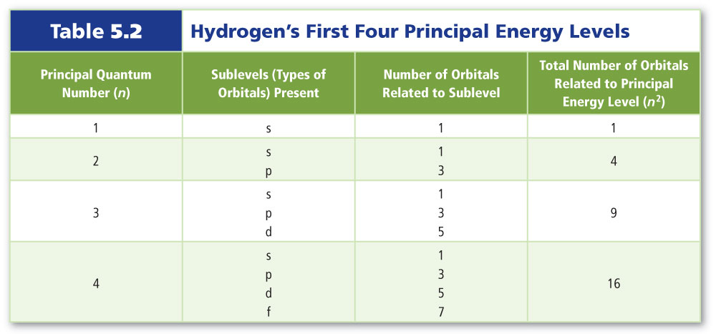
Hydrogen’s Atomic Orbitals

Slide 52
Electron Arrangement
Called ELECTRON CONFIGURATION
A series of letters & numbers giving specific information about every electron in an atom
We will use the analogy of HAWK HOTEL to describe Electron Configuration set-up and rules….

Slide 53
HAWK HOTEL ACCOMODATIONS
Single Room (s)
One “bed”
Two “guests” maximum
Located on floors 1-7

Slide 54
HAWK HOTEL ACCOMODATIONS
Prestige Room (p)
Three “beds”
Six “guests” maximum
Located on floors 2-7

Slide 55
HAWK HOTEL ACCOMODATIONS
Deluxe Room (d)
Five “beds”
Ten “guests” maximum
Located on floors 3-6

Slide 56
HAWK HOTEL ACCOMODATIONS
Fabulous Room (f)
Seven “beds”
Fourteen “guests” maximum
Located on floors 4 & 5

Slide 57
Lets write the electron configuration for the following elements in period 1
Hydrogen 1s¹
Helium 1s²

Slide 58
Let’s write the electron configuration for elements in Period 2
Lithium 1s²2s¹
Beryllium 1s²2s²
Boron 1s²2s²p¹
Carbon 1s²2s²p²
Nitrogen 1s²2s²p³
Oxygen 1s²2s²p⁴
Fluorine 1s²2s²p⁵
Neon 1s²2s²p⁶

Slide 59
Let’s write the shorthand e config for elements in Period 2
Lithium 1s²2s¹ [He] 2s¹
Beryllium 1s²2s² [He] 2s²
Boron 1s²2s²p¹ [He] 2s¹2p¹
Carbon 1s²2s²p² [He] 2s¹2p²
Nitrogen 1s²2s²p³ [He] 2s¹2p³
Oxygen 1s²2s²p⁴ [He] 2s¹2p⁴
Fluorine 1s²2s²p⁵ [He] 2s¹2p⁵
Neon 1s²2s²p⁶ [He] 2s¹2p⁶

