Slide 1
SOIL
SES3b. Explain how soil results from weathering and biological processes acting on parent rock.

Slide 2
OBJECTIVES
Describe how soil forms.
Recognize soil horizons in a soil profile.
Differentiate among the factors of soil formation.

Slide 3
KEY TERMS
Soil: the loose covering of weathered rock particles and decaying organic matter, called humus, overlying the bedrock on Earth’s surface, and serves as a medium for the growth of plants
Residual soil: a soil whose parent material is the local bedrock
Transported soil: soil that develops from parent material that has been moved far from its original location, usually by agents of erosion

Slide 4
KEY TERMS
Parent material: source rock for soil
Soil profile: a vertical sequence of soil layers
Mature soils have several distinct layers that take tens of thousands of years to develop; new soils (known as undeveloped soils) do not have these layers
Soil horizon: a distinct layer within a soil profile
Typically 4 major soil horizons in mature soils: O, A, B, and C

Slide 5
FOOD FOR THOUGHT
Think of some ways life would be different if there was no soil. How does soil impact life on Earth?
Take a few minutes to discuss with your table partner.

Slide 6
SOIL VIDEO
Bill Nye Video:
https://youtu.be/3HQwYbwmyaY (1:55)

Slide 7
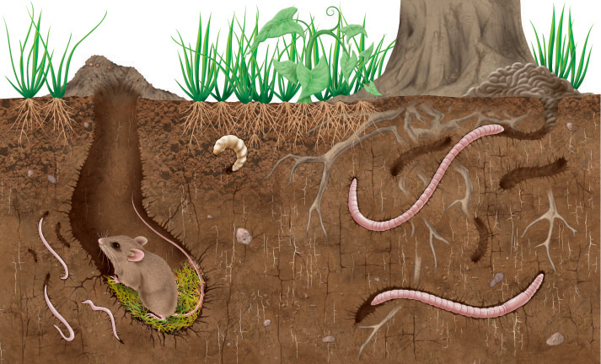
HOW SOIL DEVELOPS
Soils begin to develop when weathering breaks down bedrock into smaller pieces, which continue to undergo weathering and break down further.
Worms and other organisms break down organic matter and add nutrients to the soil and create passages for air and water.
What is helping to break up the soil in this image?

Slide 8
SOIL LAYERS & SOIL PROFILES
Through the processes of weathering, erosion, and deposition of parent material, soil will develop layers.
Residual soil has parent material that is the local bedrock; transported soil is transported from somewhere else usually through erosion.
The vertical sequence of layers make up a soil profile.

Slide 9
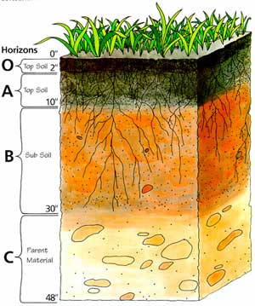
NOTE: the layer below the C-horizon is bedrock. It is sometimes referred to as the D-horizon or the R-horizon. For the purposes of this class, know that below the C-horizon is solid rock.
http://jupiter.plymouth.edu/~sci_ed/Turski/Courses/Earth_Science/soil_profile_diag.jpg

Slide 10
SOIL PROFILES
O-Horizon: top layer of organic material; composed of humus and leaf litter
A-Horizon: layer of weathered rock combined with a rich concentration of dark brown organic material
http://jupiter.plymouth.edu/~sci_ed/Turski/Courses/Earth_Science/soil_profile_diag.jpg

Slide 11
SOIL PROFILES
B-Horizon: known as the zone of accumulation, is a red or brown layer enriched over time by clay and minerals deposited by water flowing from above, or percolating upward from below
http://jupiter.plymouth.edu/~sci_ed/Turski/Courses/Earth_Science/soil_profile_diag.jpg

Slide 12
SOIL PROFILES
C-Horizon: little or no organic matter; often made of broken-down bedrock (known as aggregate)
http://jupiter.plymouth.edu/~sci_ed/Turski/Courses/Earth_Science/soil_profile_diag.jpg

Slide 13
QUICK QUESTION
Given the makeup of the different soil horizons, why would a farmer or gardener till their soil at the beginning of the growing season?
Take a couple of minutes to discuss this with your table partner and be prepared to discuss it with the class.

Slide 14
SOIL FORMATION
Five factors:
Climate
Most significant factor because it impacts the weathering of rocks
Topography
Affects the type of soil that forms
Sunlit slopes will have more vegetation
Parent Material
Residual soils have same chemical compound as local bedrock; transported soils likely won’t

Slide 15
SOIL FORMATION
Biological Organisms
All organisms interact with the soil
Different types of biological organisms can lead to different soil orders
Time
Determines the characteristics of a soil
The longer weathering occurs, the greater the chance original minerals are changed or washed away

Slide 16
SOIL TEXTURE
Simply put, it’s the relative size of soil particles and impacts a soil’s capacity to retain moisture and ability to support plant growth.
Soil texture triangle determines a soil’s texture.

Slide 17
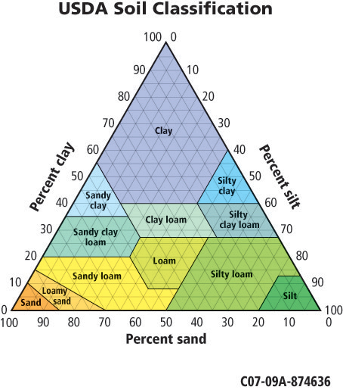

Slide 18
Describe how soil forms.
Summarize the features of each horizon of soil.
Classify a soil profile based on whether it is a mature or immature.

