Slide 1
Unit 1 Lesson 1

Slide 2
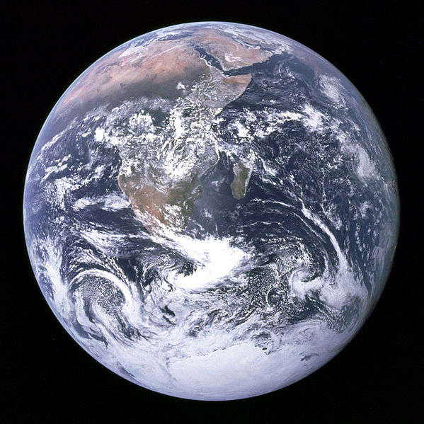
Describe the picture. What do you think is going on in this picture?
Notes:
Famous “Blue Marble” photo

Slide 3
Four major parts of Earth work together as a complex system. On a global scale, each part can be thought of as a sphere, roughly the same size and shape as the planet. The four parts are called the geosphere, hydrosphere, atmosphere, and biosphere.
(2 min) On your worksheet, write in your own words what you think the definition is for each of these spheres.

Slide 4
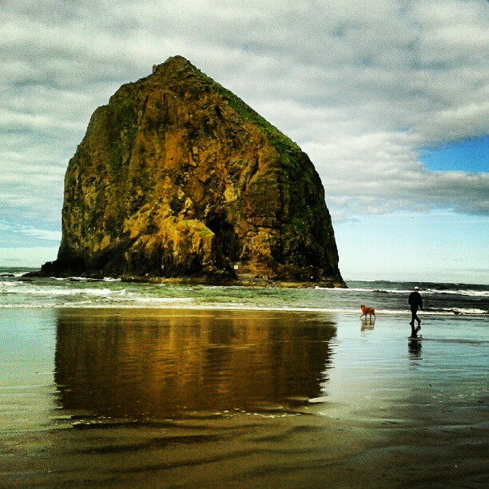
What is the Geosphere (Lithosphere)?
Earth’s core, mantle, and crust (all of Earth’s rock)
Examples: continents, rocks, ocean floor, sand, metal, brick, and asphalt
Notes:
My Image: Haystack Rock, Cannon Beach, Oregon

Slide 5
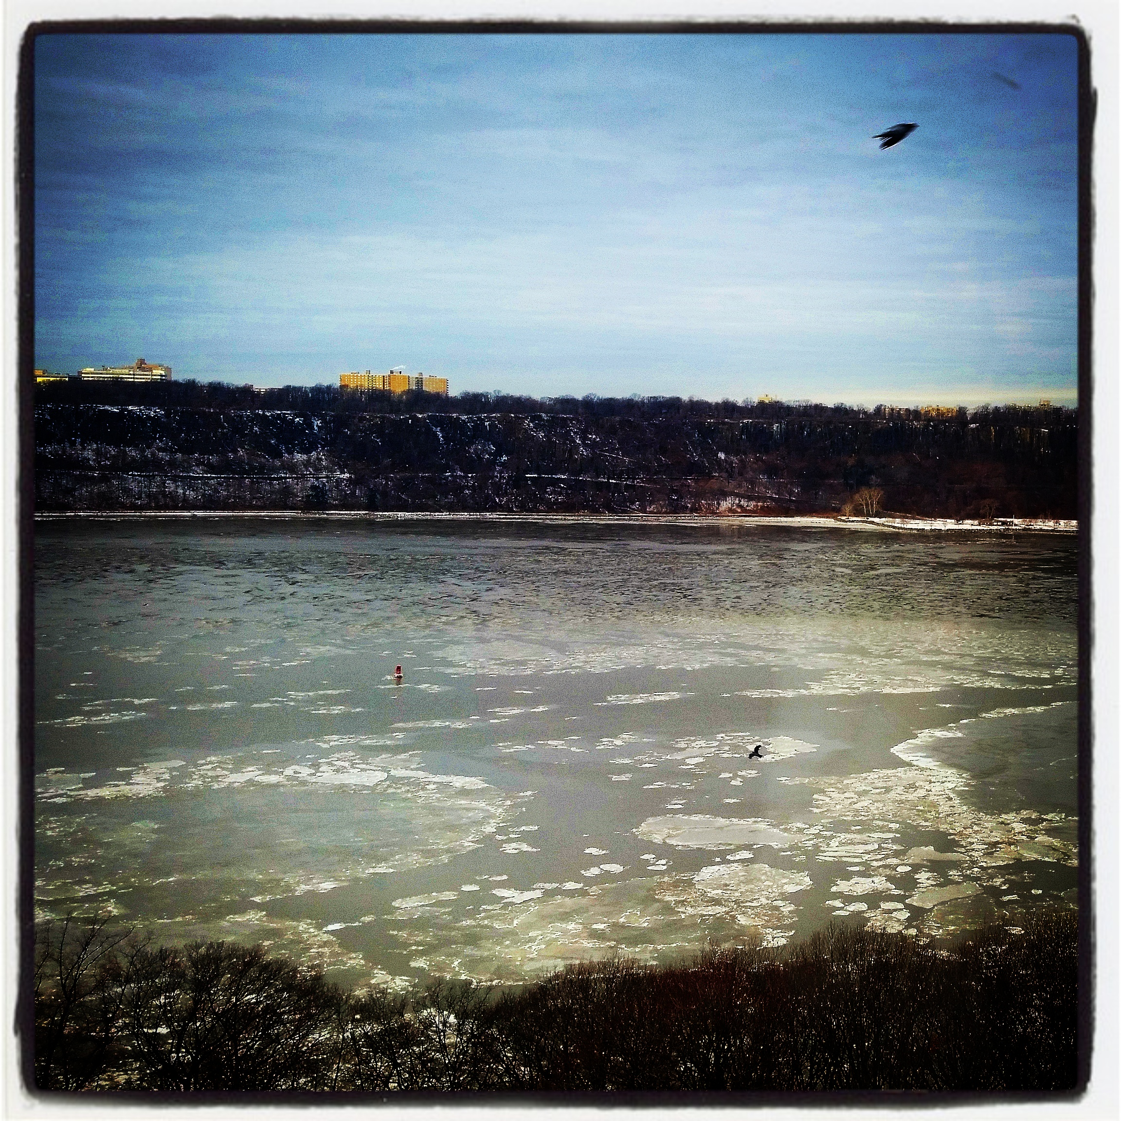
What is the Hydrosphere?
Earth’s water
Examples:
oceans, lakes, rivers, groundwater, glaciers, polar ice caps, rain, and snow
Notes:
My Image: Hudson River with Ice, NY, NY

Slide 6
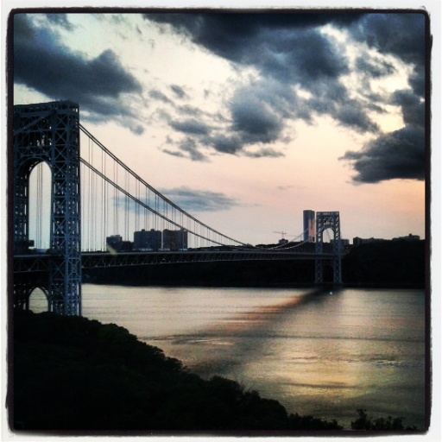
What is the Atmosphere?
Earth’s gases
Examples: oxygen, nitrogen, water vapor, ozone and wind
Notes:
My Image: George Washington Bridge with Clouds, NY, NY

Slide 7
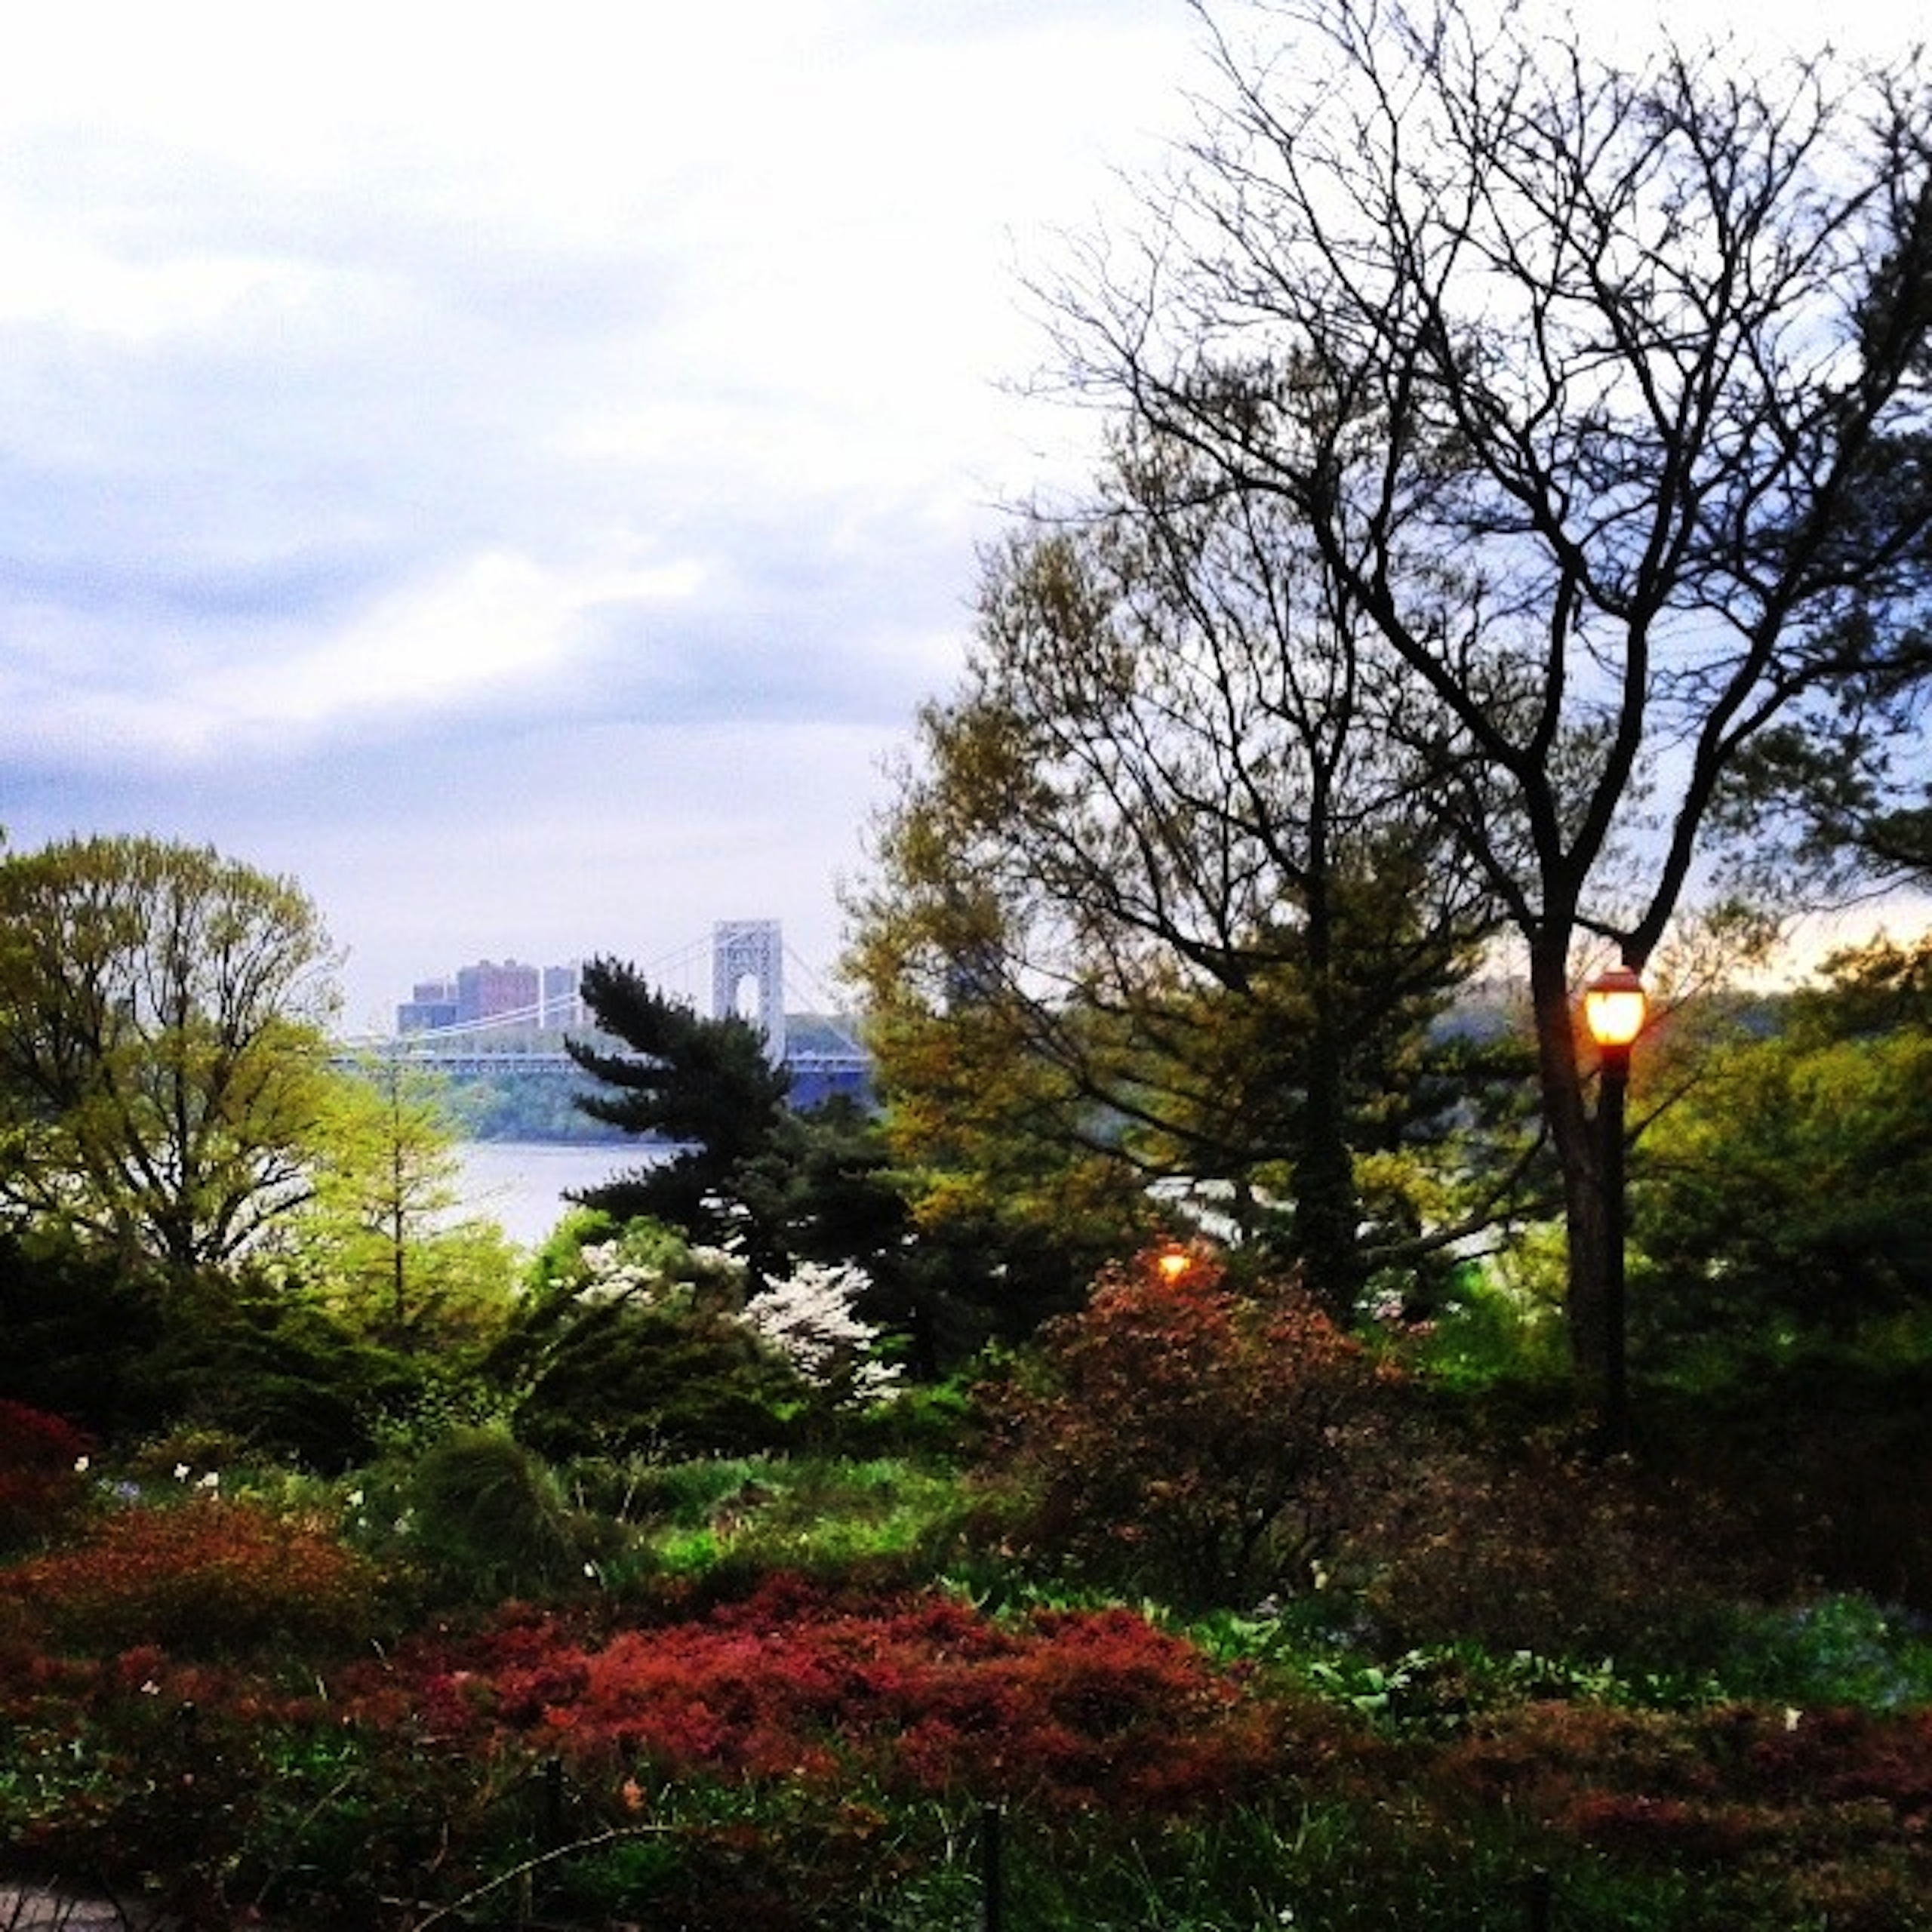
What is the Biosphere?
Earth’s living
organisms
Examples:
such as plants, humans, animals, insects and microbes
Notes:
My Image: Ft. Tryon Park, NY, NY

Slide 8
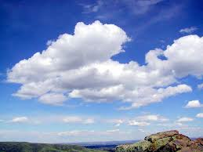
Do you think clouds should be classified as part of the atmosphere, or part of the hydrosphere? Explain why.

Slide 9
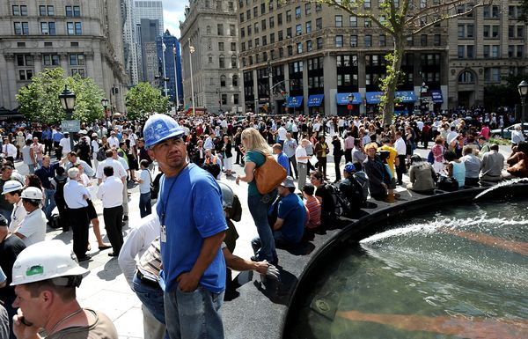
Practice! With your partner, label and describe each of Earth's four spheres in your photograph.
Geosphere: Buildings made of stone from the Earth
Biosphere: People are living organisms

Slide 10
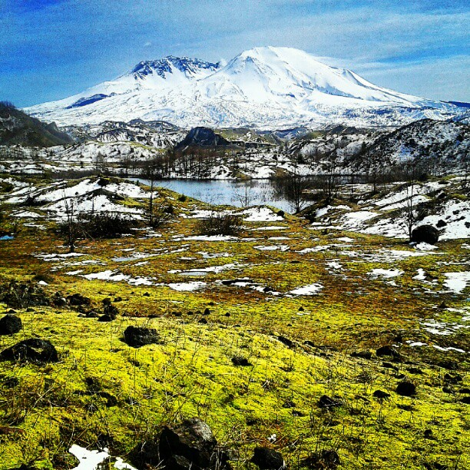
Notes:
My Image: Mt. St. Helens

Slide 11
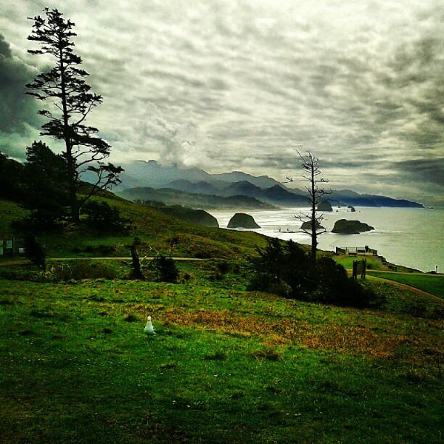
Notes:
My Image: Ecola State Park, Oregon

Slide 12
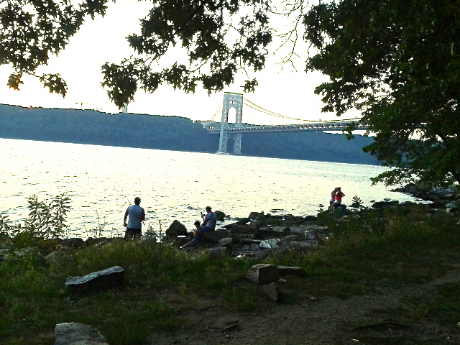
Notes:
My Image: Riverside Park, Hudson River, NY, NY

