Slide 1
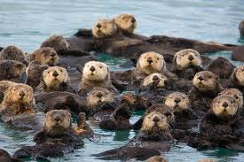
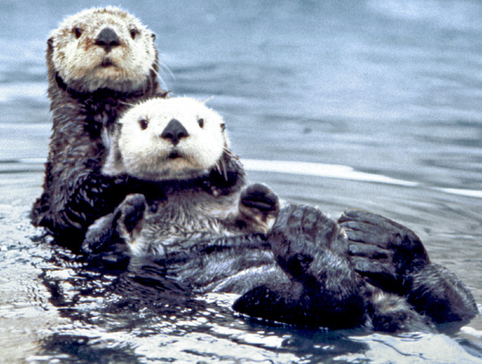
Species Are Connected to Ecosystems
Some species are clearly critical to the functioning of an ecosystem.
Keystone species - a species that is critical to the functioning of the ecosystem in which it lives. It affects the survival and abundance of many other species in its community.
Sea otter
The loss of the sea otter populations led to an unchecked sea urchin population, which ate all the kelp leading to the loss of kelp beds along the U.S. Pacific Coast.
https://www.britannica.com/science/keystone-species

Slide 2
Keystone Species
Sea Otters Keystone Species
20 mins Keystone Species
How Wolves Changed The Rivers

Slide 3
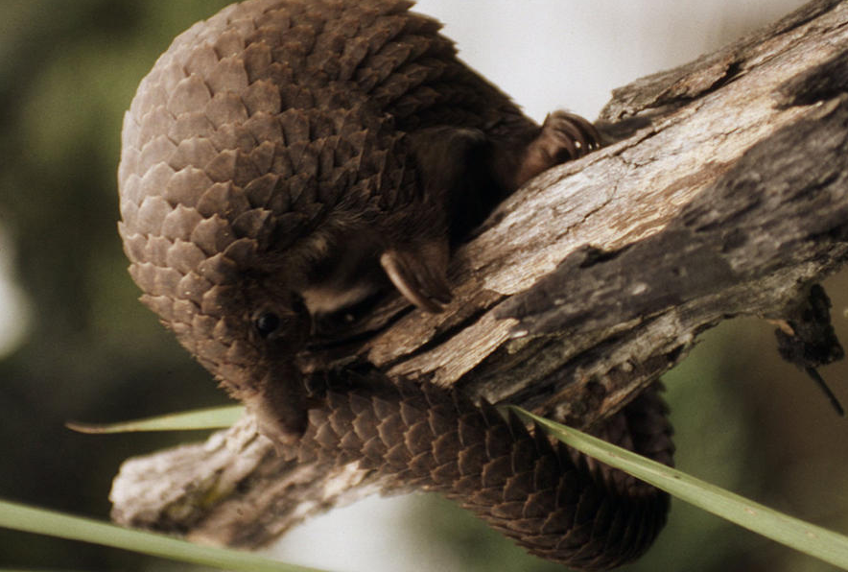
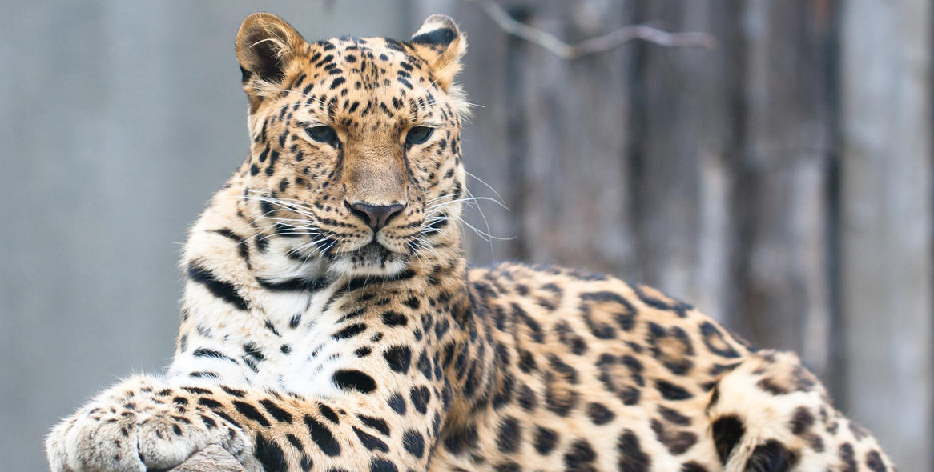
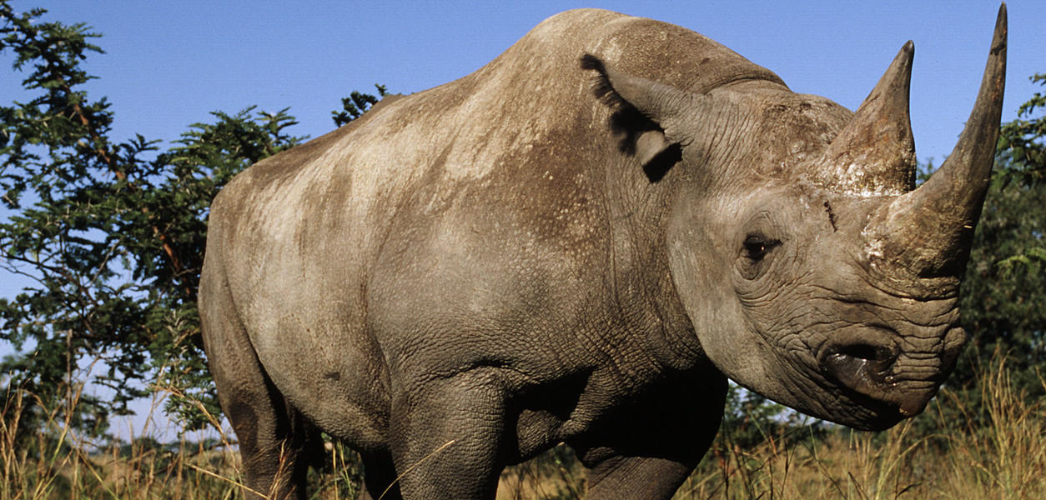
Biodiversity of species
Endangered Species
A species that is likely to become extinct if protective measures are not taken immediately

Slide 4
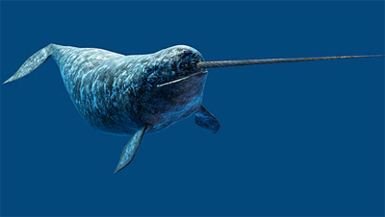
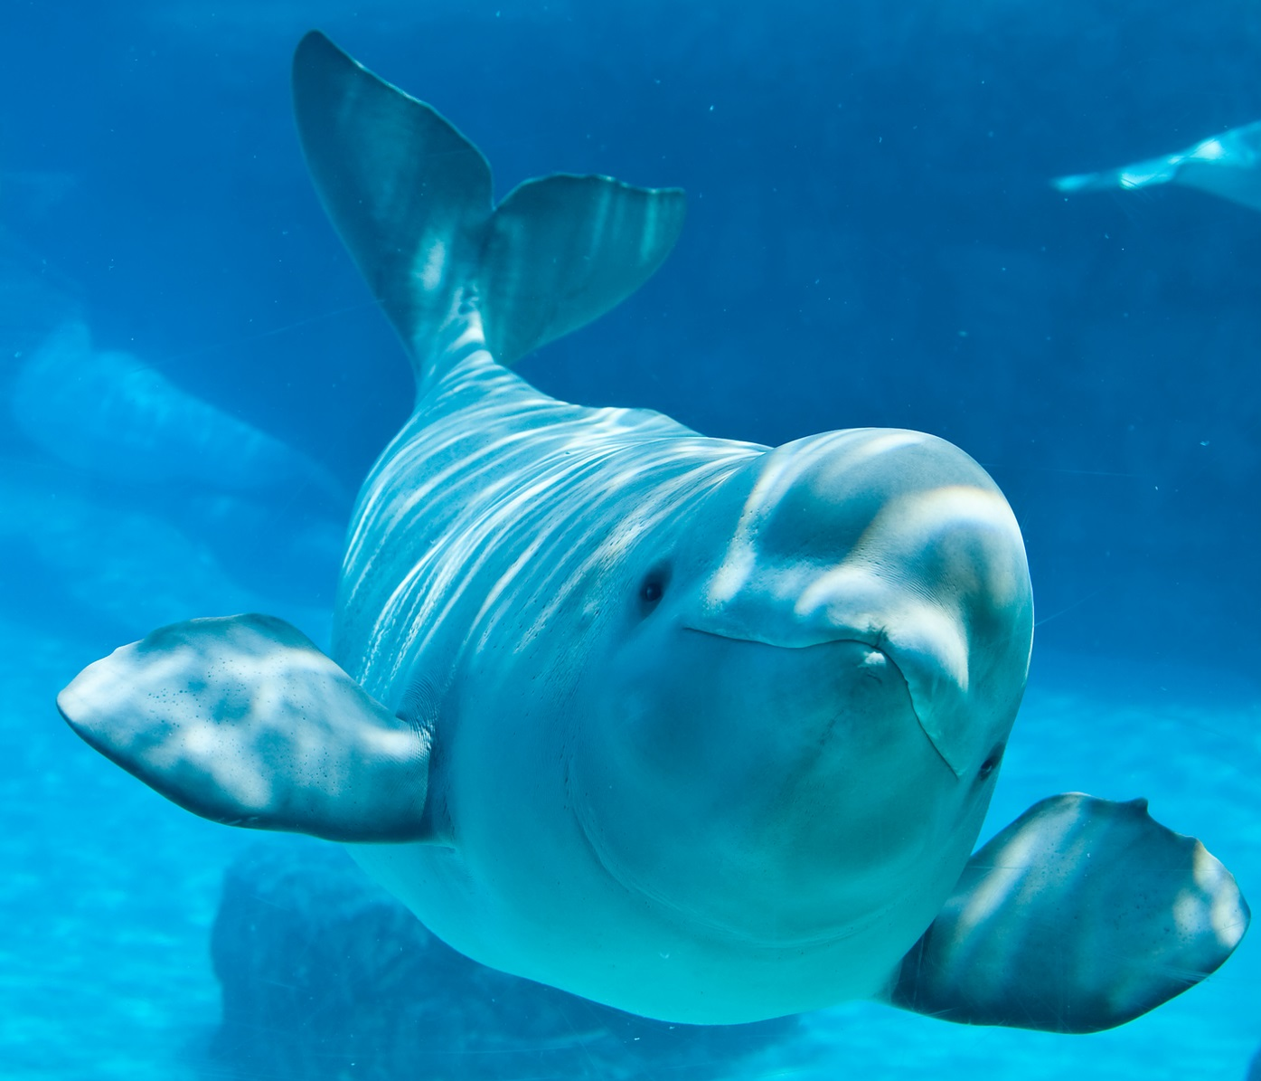
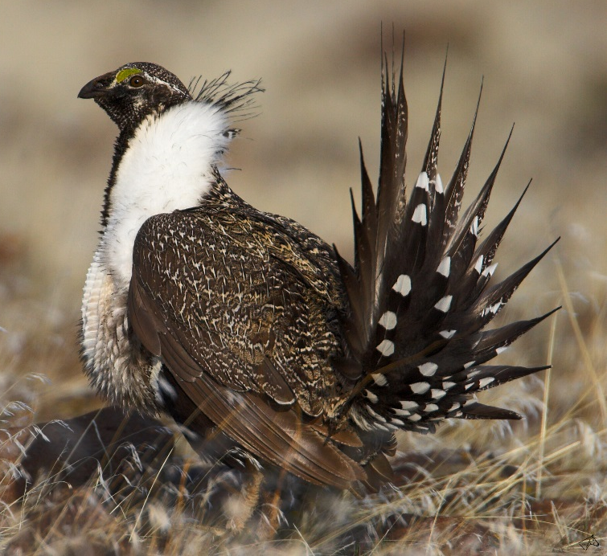
Threatened Species
A species that has a declining population and that is likely to become endangered if it is not protected.

Slide 5
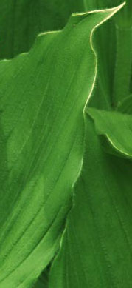
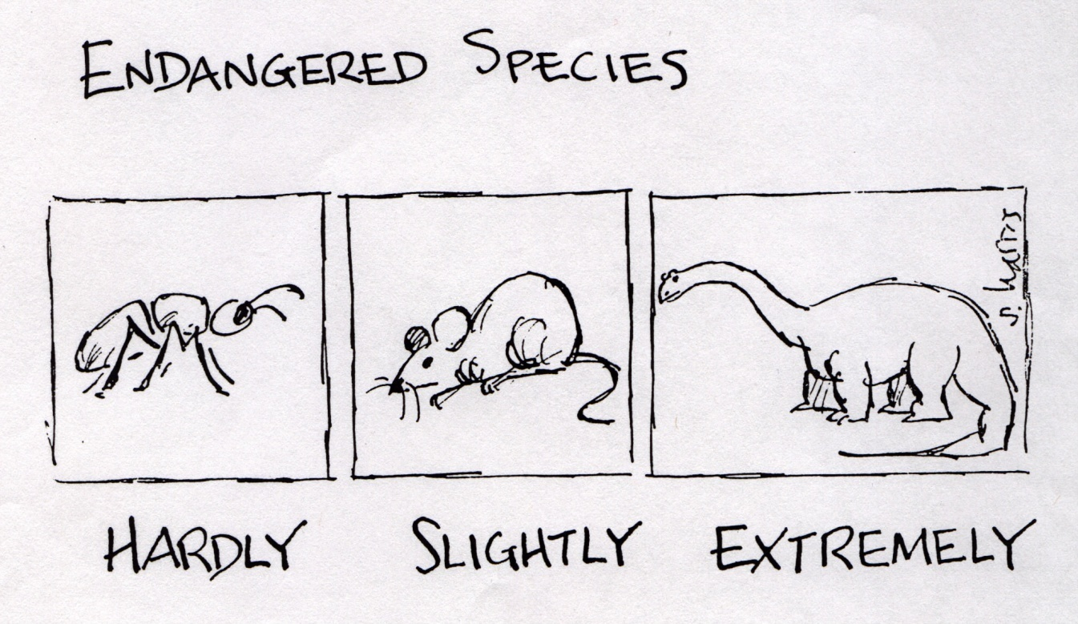
ENDANGERED VS THREATENED
Threatened: population low but extinction is not about to happen
Endangered: population so low that extinction is possible

Slide 6
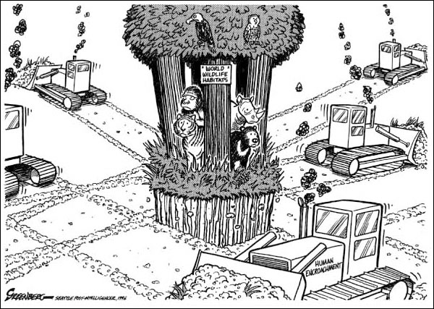
THE GREATEST THREAT

Slide 7
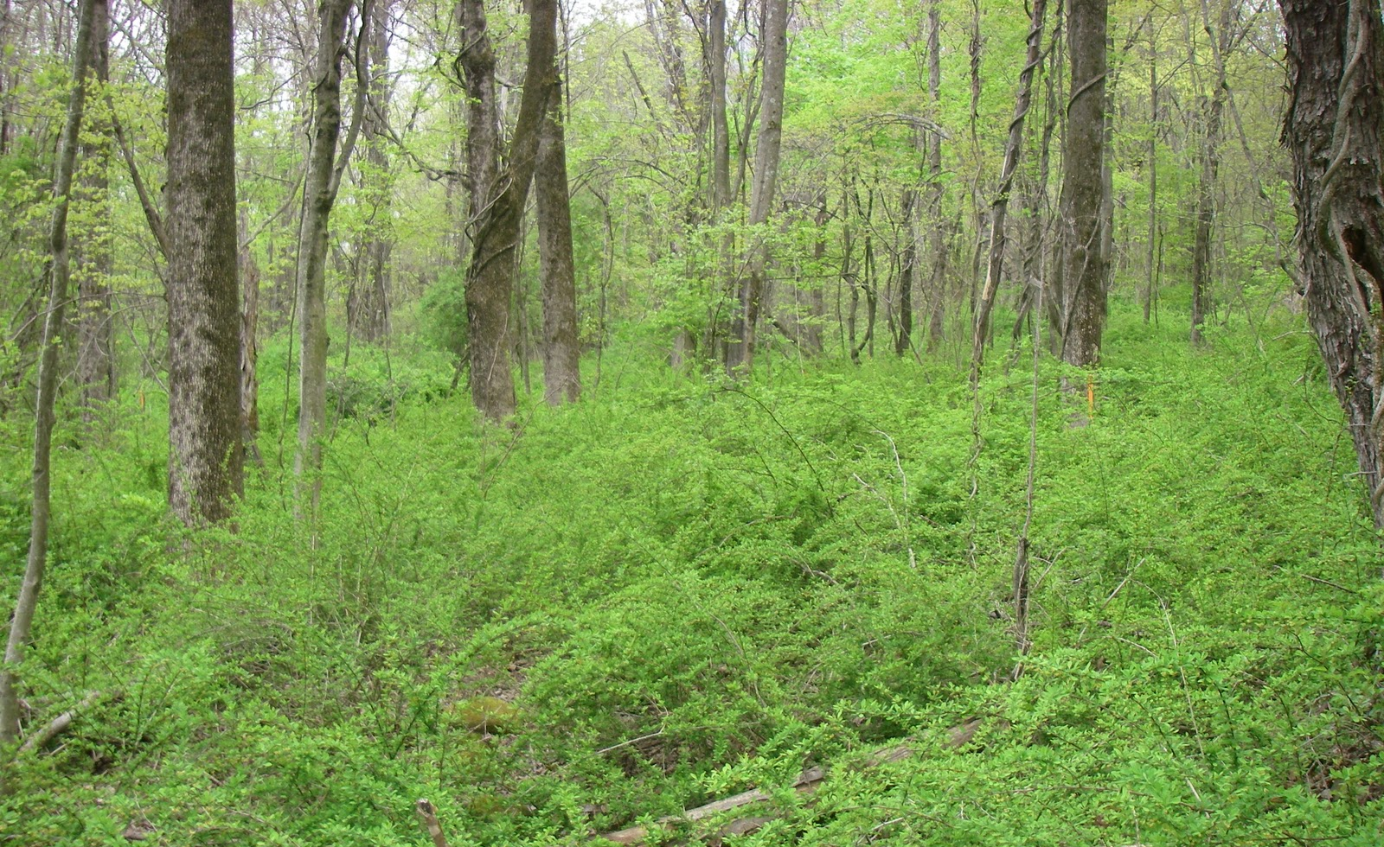
Invasive Species
An introduction

Slide 8
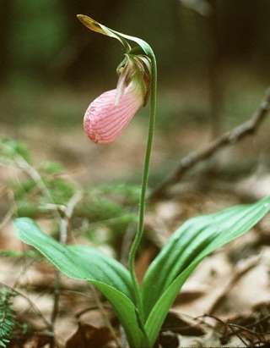
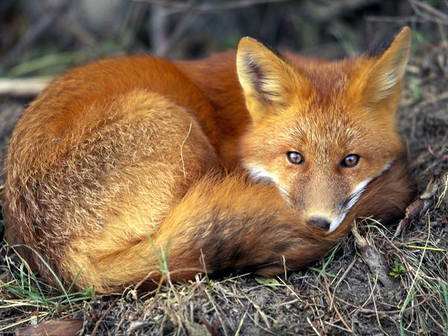
Native Species
Native species: a species that is endemic (common) or indigenous to a particular area
Normally live and thrive in a particular community
Pink lady's slipper, Cypripedium acaule
Red fox, Vulpes vulpes

Slide 9
Native Species
Occupy specific habitats and have specific niches in native environment.
Have natural predators that help to keep their populations in check.
Pink lady's slipper, Cypripedium acaule
Red fox, Vulpes vulpes

Slide 10
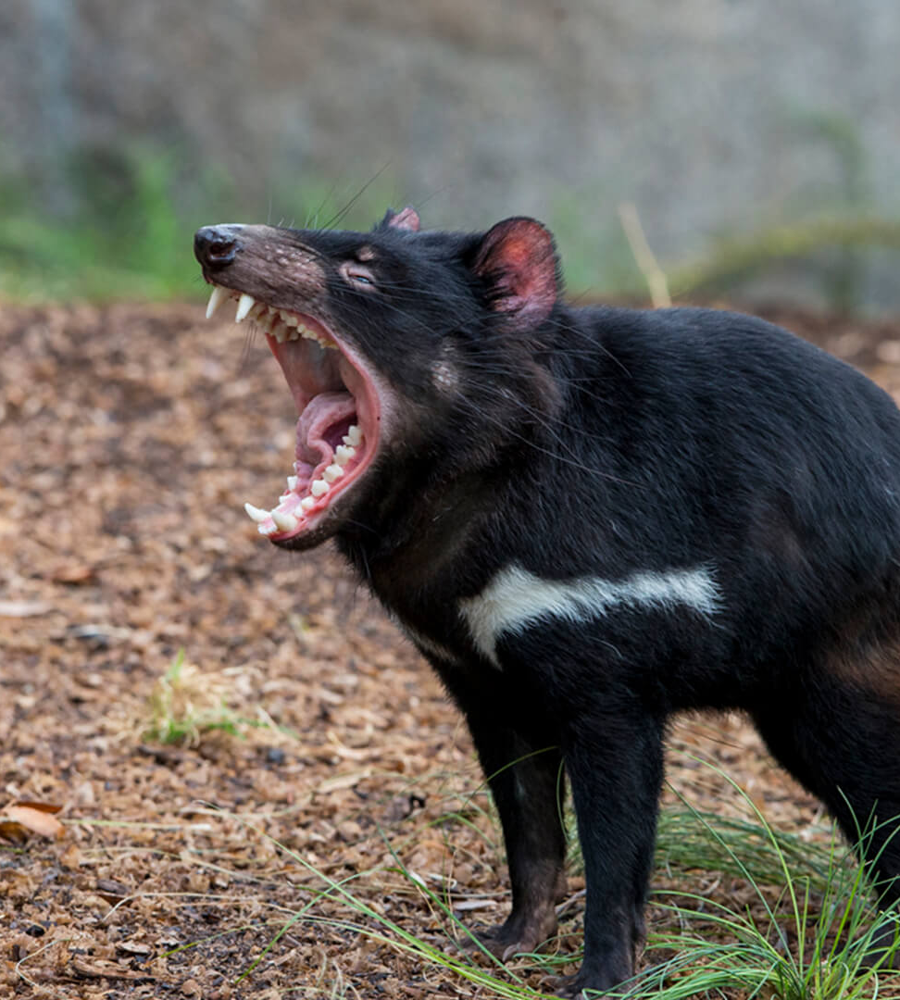
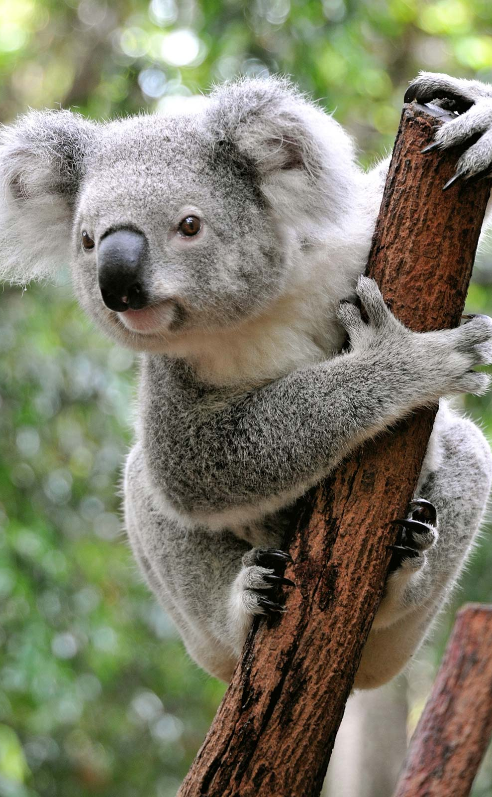
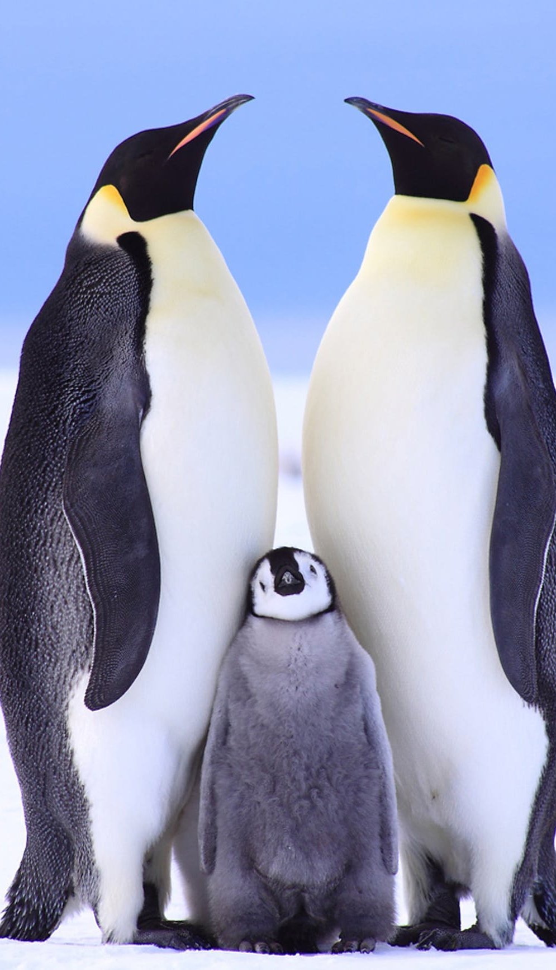
Endemic Species
Plants or animals that exist only in one geographic region.
May exist on one island or specific continent
Examples:
Koala
Tasmanian devil
Emperor penguin
Notes:
Changes in climate or habitat — often brought on by the climate crisis — can greatly threaten endemic species, bringing them closer to endangerment or extinction.
Koala – Australia
Tasmanian devil https://youtu.be/sRb2nTo3W4g Australia
Emperor penguin – endemic to Antarctica

Slide 11
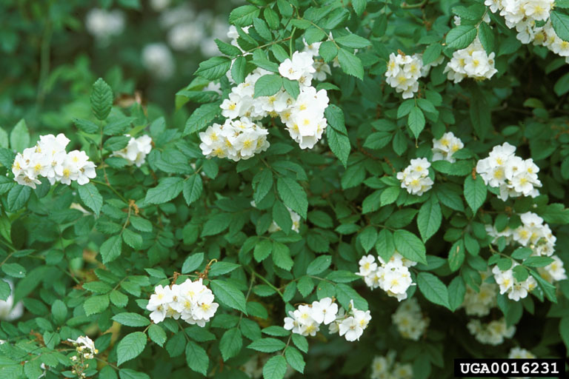
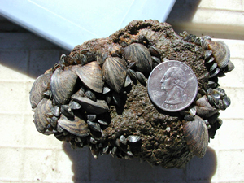
Non-native species
A species living outside its native distributional range
Arrived by human activity, either deliberate or accidental.
Non-native species are not necessarily invasive.
Multiflora rose, Rosa multiflora, was introduced for use as an ornamental plant, to control erosion, and to use as “living” fences for livestock.
Zebra mussels (Dreissena polymorpha), were accidentally introduced to North America, and are now found in some Pennsylvanian waterways

Slide 12
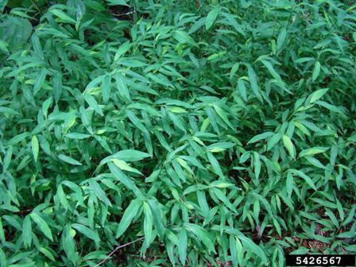
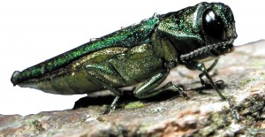
Non-native invasive species
A non-native species that adversely (badly) affects habitats and biodiversity within an ecosystem
Emerald ash borer, Agrilus planipennis , has killed millions of ash trees in the mid-west and has recently been found in Pennsylvania
Japanese stilt grass, Microstegium vimineum, becomes established on recently disturbed areas and outcompetes native plants, reducing biodiversity.

Slide 13
Common characteristics of invasive species
Invasive species in general:
Have few natural predators, competitors, parasites or diseases
Have high reproductive rates
Are long-lived
Are generalists
Are pioneer species
Characteristics that make Zebra mussels a good invader include its ability to tolerate a wide-range of environments, and high reproduction rate; female mussels release up to 100,000 eggs ability to tolerate a wide-range of environments year.
Discussion: how would these characteristics enable a species to become invasive?

Slide 14
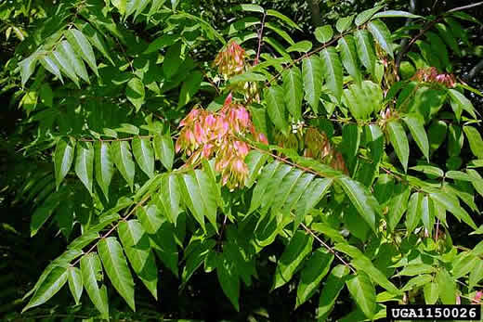
Common traits to invasive plants
Self-compatible
Flower early
Produces abundant seed
Disperse seed widely
Grow rapidly
Spread asexually
Strong competitors
Characteristics that make tree-of-heaven a good invader include its ability to flower early (within 2 years), ability to spread asexually, and fast growth rate.

Slide 15
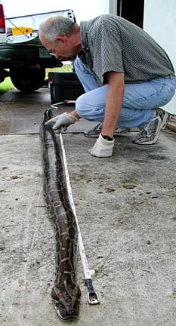
Burmese Python
Burmese python captured on an access road to Florida's Everglades National Park.
Experts say the snake species is one of the world's largest and a favorite of the pet trade.
Released by disenchanted pet owners.
The News-Press reported that the Florida Fish and Wildlife Conservation Commission and the Southwest Florida Water Management District removed nearly 2,000 invasive pythons in the first eight months of 2020, surpassing 2019 totals. As of mid-October, the teams removed nearly 4,000 snakes bringing the total snakes removed since the program’s inception in 2017 to 6,278.
Notes:
https://miami.cbslocal.com/2020/11/16/thousands-invasive-pythons-removed-florida-everglades/
https://www.naplesnews.com/videos/news/environment/2019/11/14/everglades-python-hunter-helps-maintain-ecosystem-she-loves-removing-invasive-species/4182842002/
https://www.usatoday.com/story/news/nation/2020/11/16/python-hunters-break-records-after-state-agencies-combine-forces/6316389002/

Slide 16
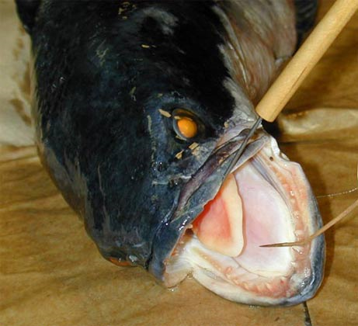
Example: Northern Snakehead
Native to China, the northern snakehead now found in Maryland ponds and the Potomac River.
It has a small head, large mouth, big teeth, and ability to wriggle across land.
It grows up to 40 inches (100 centimeters) long and can weigh up to 15 pounds.
It is a voracious feeder and can decimate native fish stocks in North American waters.
The fish can survive for several days out of water.

Slide 17
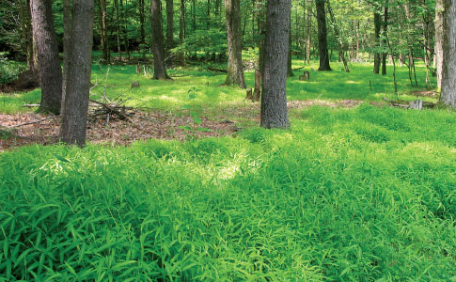
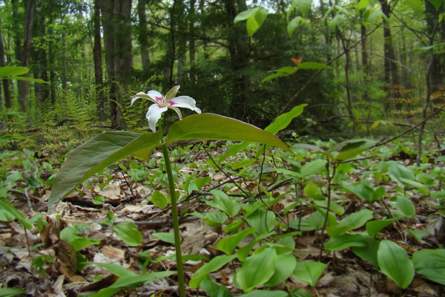
Impacts of invasive species
Displace native species
Japanese stilt grass displaces native herbaceous plants, reducing biodiversity, and reducing food available for wildlife species.
Monoculture of Japanese stilt grass, prevents establishment of native herbaceous species
Diversity of herbaceous species increases wildlife habitat

Slide 18
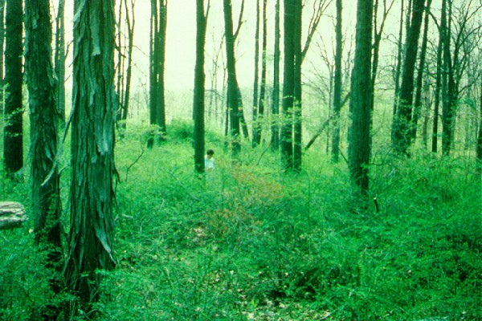
Impacts of invasive species
Reduce forest health and productivity
Monoculture of Japanese barberry prevents the establishment tree seedlings

Slide 19
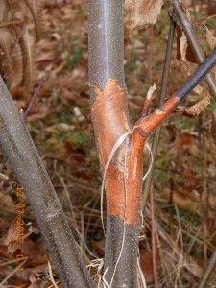
Impacts of invasive species
Some invasive species kill native species
About ¼ of the hardwood trees in Pennsylvania used to be American chestnut. The invasive chestnut-blight fungus killed most American chestnut throughout the eastern US by 1950.
American chestnut, Castanea dentata, at Grey Towers National Historic Site in Milford, PA, circa 1905
American chestnut infected with chestnut blight fungus, Cryphonectria parasitica

Slide 20
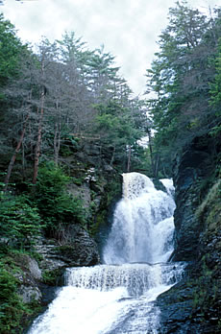
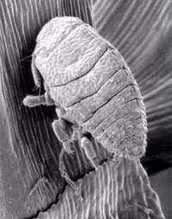
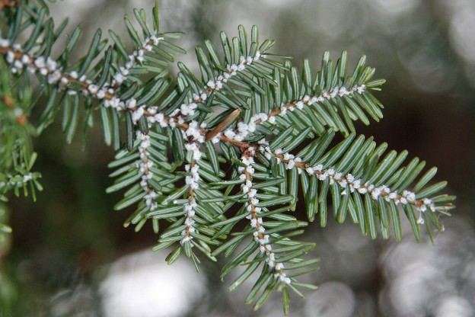
Indirect Impacts of invasive species
Hemlock woolly adelgid kills Eastern hemlock trees in Pennsylvania and the northeast.
Eastern hemlock forests play an important role in maintaining stream temperatures and oxygen levels favorable for brook trout.
Hemlock mortality leads to increased water temperatures and oxygen levels, and therefore reduced brook trout populations.
Hemlock woolly adelgid
Hemlock woolly adelgid infestation
Hemlock mortality along stream bank

Slide 21
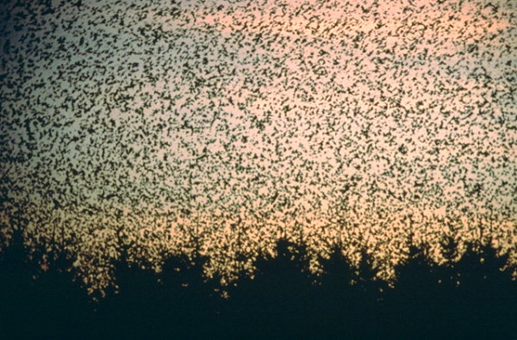
Economic Impacts of invasive species
Invasive species are responsible for tremendous economic losses through:
loss in forest and agricultural productivity
spread of diseases that impact humans
European starlings, spread diseases to wildlife, livestock, and humans, damage agricultural crops, and displace native birds.
Their damage to agricultural crops is estimated at $800 million annually.
Notes:
https://www.youtube.com/watch?v=XufasdTrLb8&feature=emb_logo
Their aggression and territorial takeover habits have displaced and killed off many native songbirds. They are considered invasive by the US Fish and Wildlife Service.
Their corrosive droppings can damage all kinds of objects and surfaces.
They spread the seeds of weeds and eat large amounts of grain crops.
Because of their enormous flocks, they can interfere with aviation.
Their dominance at backyard bird feeders can push out the native bird visitors.

Slide 22
Use video & answer questions
http://www.pbs.org/video/2365817308/

